Slide 1


BGB-58067 Integrated Evidence Plan
Version 1.0
August 2026
Prepared by:
Notes:
Reference boxes on notes pages follow the same order as those on slides, though these references will be longer. This box should be bottom aligned with the page with a .1 boarder at the bottom.

Slide 2
Table Of Contents
Chapter | Topics | Page
Executive Summary | Asset Context and Purpose of the IEP | 6-9
 | Overview of Priority Evidence Gaps | 9
 | Tactics Overview and IEP Roadmap | 10-11
Situational and Strategic Context | Product and CDx Strategy | 13-14
 | PRMT5i Competitive Landscape | 15
 | Medical Strategic Imperatives | 16
Prioritized Evidence Gaps | Gap Prioritization Framework | 18
 | Overview of Prioritized Evidence Gaps | 19-21
 | Rationale for Prioritized Evidence Gaps and Respective Tactics | 22-28
Tactical Synergies | Post-Hoc Analyses | 30-32
 | Systematic Literature Reviews | 33
 | Modelling Study | 34
 | Indirect Treatment Comparisons (ITCs) | 35-36
 | Real-World Evidence (RWE) Studies | 37-39
 | Investigator-Initiated Trials (IITs) | 40-44
 | Surveys | 45
Gated Gaps | Overview of Gated Gaps Deprioritized for Tactical Development | 47-51
Planned / Addressed Tactics | List of Planned/Addressed Tactics | 53-56

Slide 3
V1.0 BGB-58067 IEP DISCLAIMER
Note To Reader:
V1.0 of the IEP was originally developed based on a single-arm, later-line (2L+) trial design and was subsequently updated to reflect a 2L+ randomized controlled trial (RCT) design.
The IEP should be refreshed once the 2L+ RCT design has been finalized following the Phase 1 data readout to reassess evidence gaps and tactical approaches relevant to the 2L+ NSCLC setting.

Slide 4
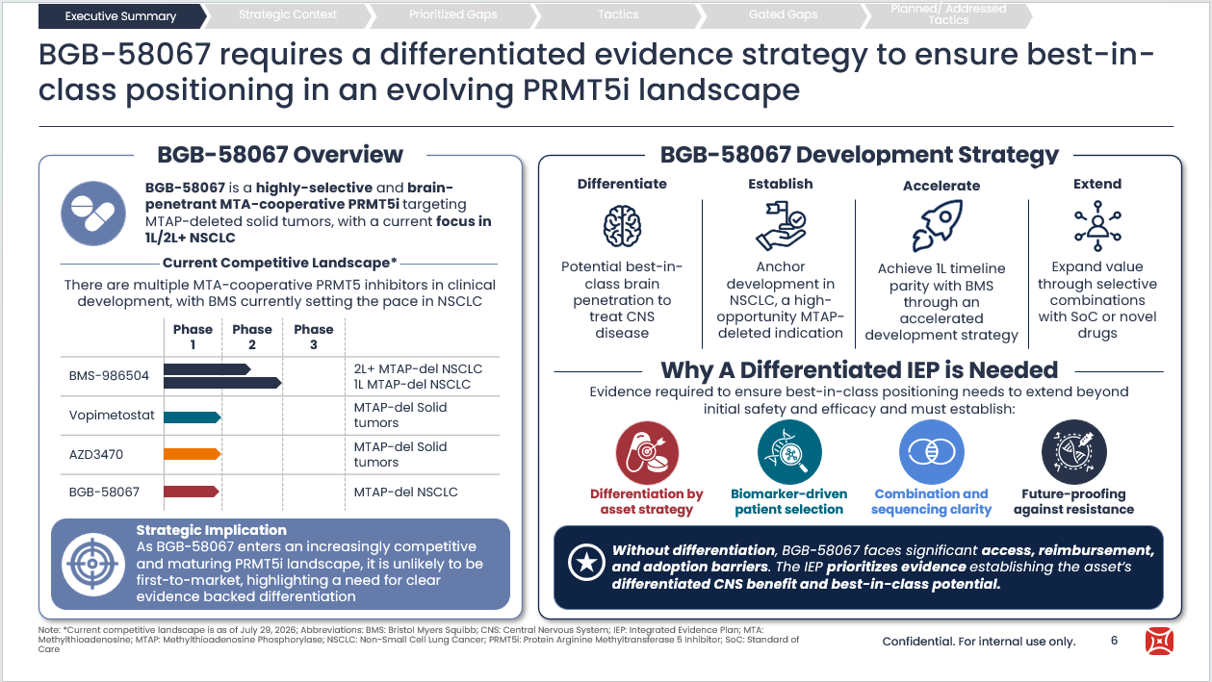
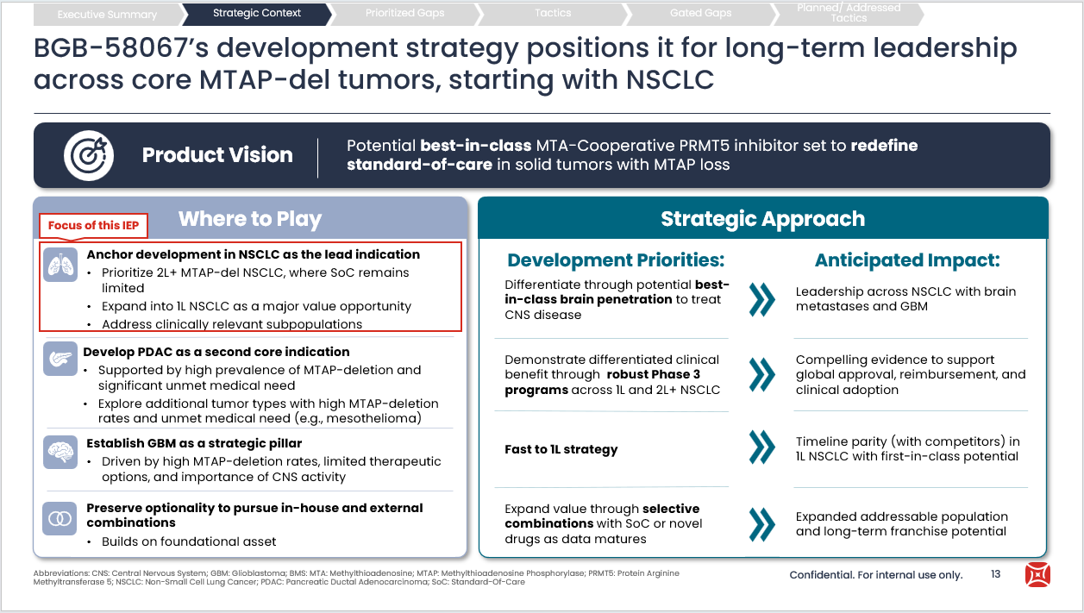
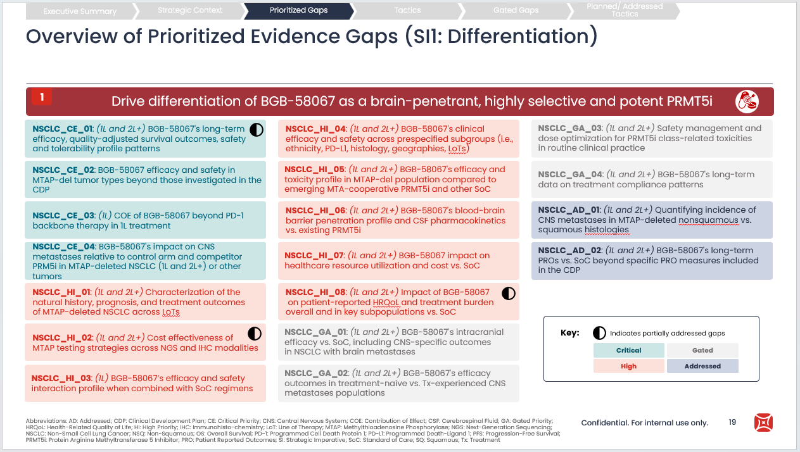
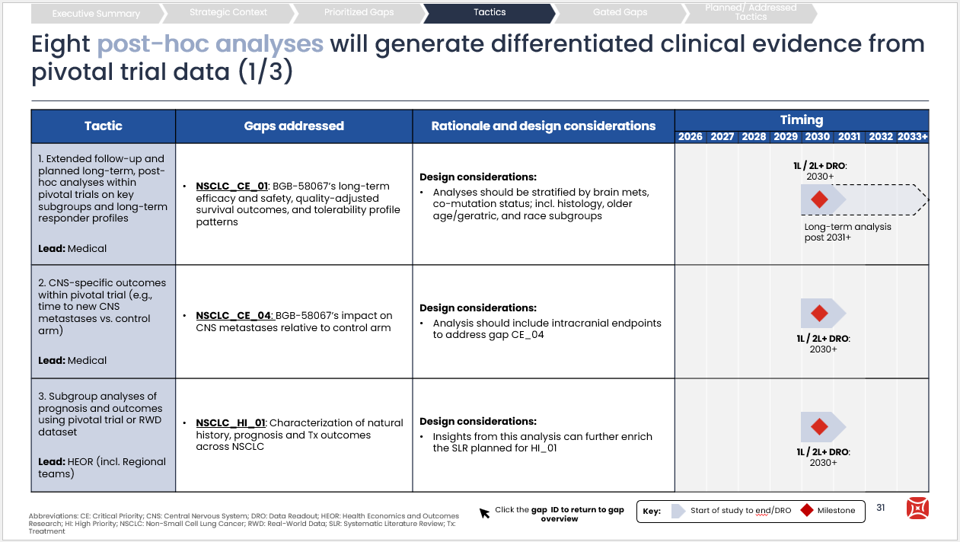
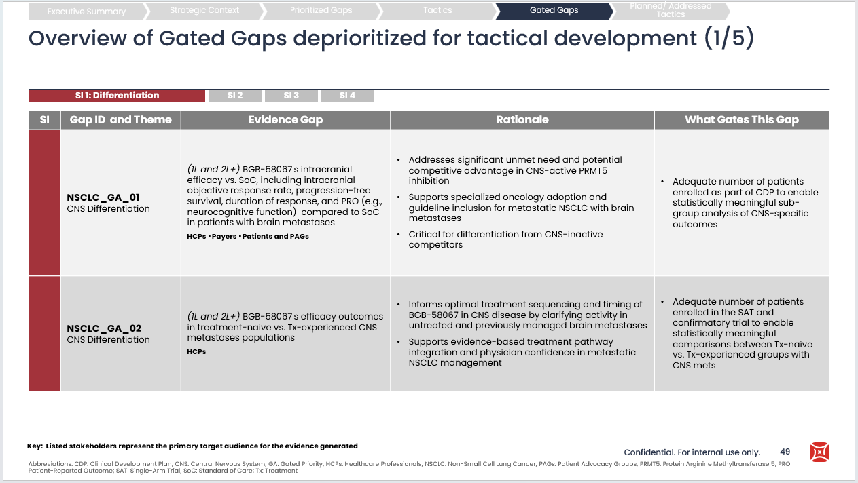
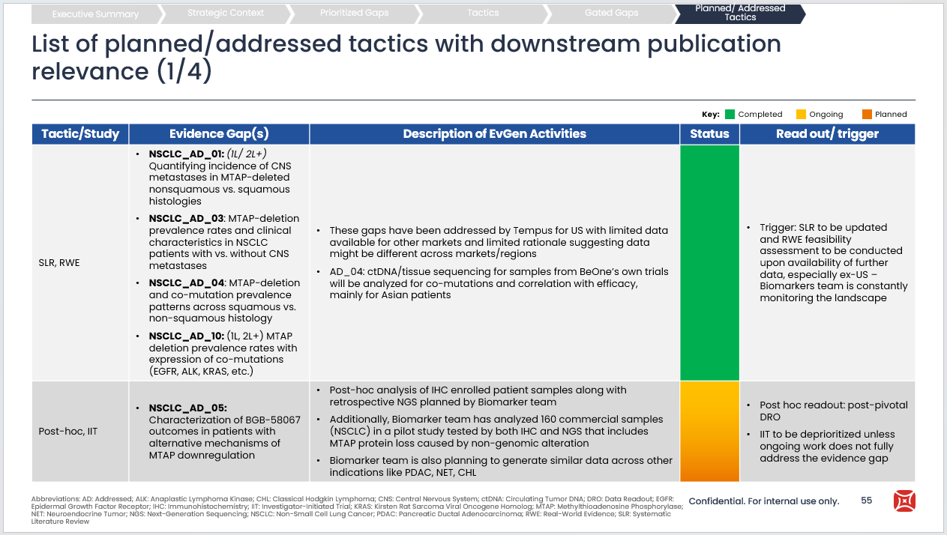
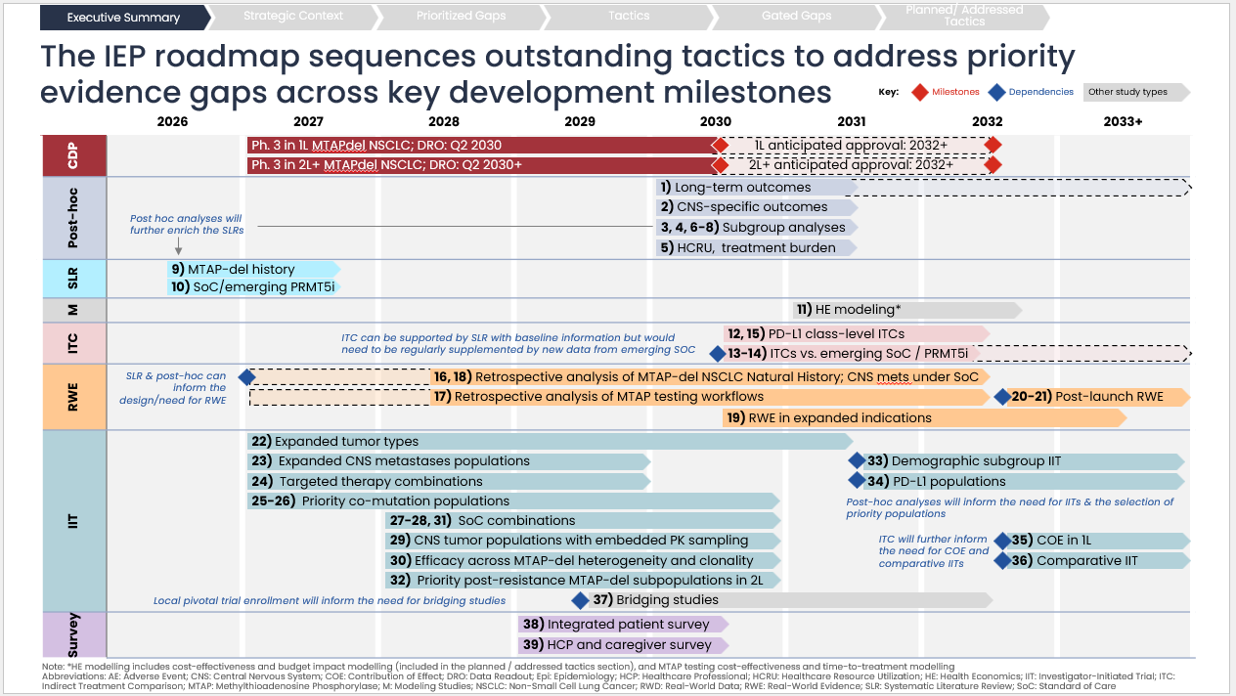
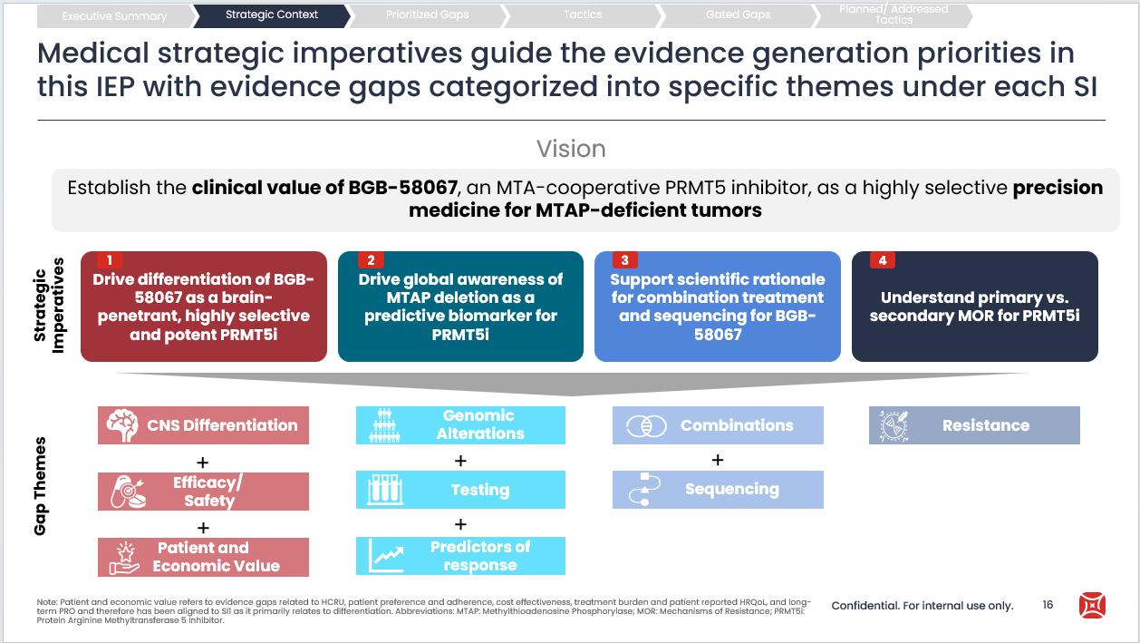
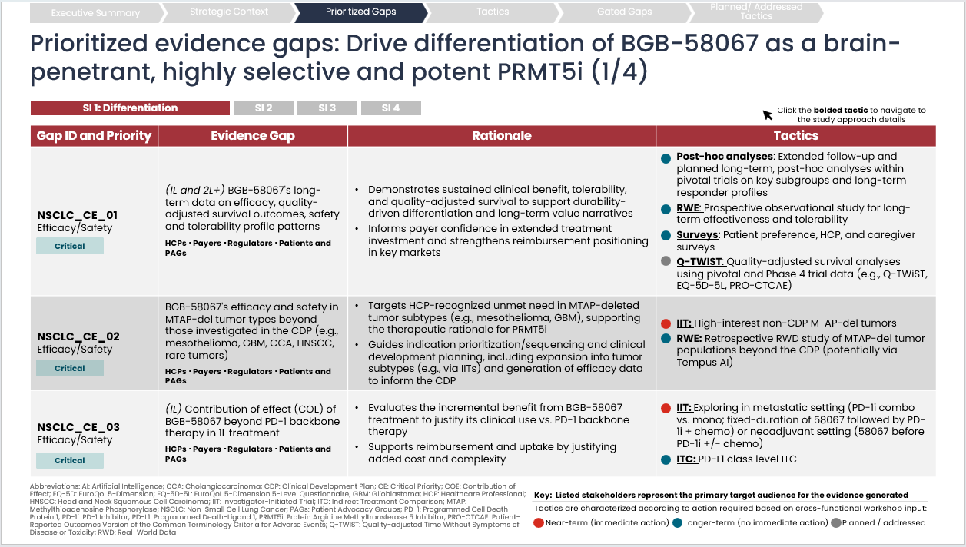
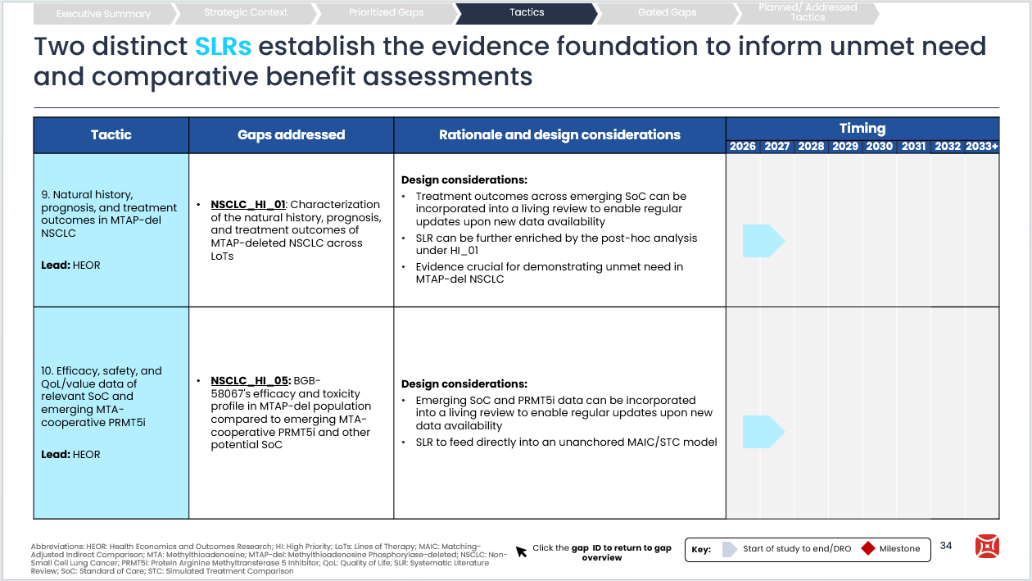
IEP Structure & Flow
This IEP is organized into the following key sections aligned with the BeOne IEP Guidance Document V1.1 March 2026
Executive Summary
Strategic Context
Prioritized Evidence Gaps
Tactics Overview
Gated Evidence Gaps
Planned / Addressed Tactics
Overview of the IEP report summarizing strategic context, evidence gaps and key tactics roadmap
BGB-58067’s underlying cross-functional strategy acting as the foundation of the IEP
Prioritized evidence gaps beyond the CDP based on functional and regional perspectives highlighting their strategic importance and key tactics
Ideated tactics to address evidence gaps requiring near-and further-term planning / execution
Details on gated evidence gaps outlining the rationale for inclusion and the conditions under which they should be revisited
List of addressed gaps and planned, ongoing, and addressed evidence generation tactics
Abbreviations: CDP: Clinical Development Plan; IEP: Integrated Evidence Plan
Sources: BeOne IEP Guidance Document Version 1.0 (Dec 2025)

Slide 5
Executive Summary
Executive Summary
Strategic Context
Prioritized Gaps
Tactics
Gated Gaps
Planned/ Addressed Tactics

Slide 6
BGB-58067 requires a differentiated evidence strategy to ensure best-in-class positioning in an evolving PRMT5i landscape
Executive Summary
Strategic Context
Prioritized Gaps
Tactics
Gated Gaps
Planned/ Addressed Tactics
BGB-58067 Overview
BGB-58067 Development Strategy
Differentiate
Potential best-in-class brain penetration to treat CNS disease
Establish
Anchor development in NSCLC, a high-opportunity MTAP-deleted indication
Accelerate
Achieve 1L timeline parity with BMS through an accelerated development strategy
Extend
Expand value through selective combinations with SoC or novel drugs
BGB-58067 is a highly-selective and brain-penetrant MTA-cooperative PRMT5i targeting MTAP-deleted solid tumors, with a current focus in 1L/2L+ NSCLC
Current Competitive Landscape*
There are multiple MTA-cooperative PRMT5 inhibitors in clinical development, with BMS currently setting the pace in NSCLC
 | Phase 1 | Phase 2 | Phase 3
BMS-986504 |  |  |  | 2L+ MTAP-del NSCLC 1L MTAP-del NSCLC
Vopimetostat |  |  |  | MTAP-del Solid tumors
AZD3470 |  |  |  | MTAP-del Solid tumors
BGB-58067 |  |  |  | MTAP-del NSCLC
Why A Differentiated IEP is Needed
Evidence required to ensure best-in-class positioning needs to extend beyond initial safety and efficacy and must establish:
Differentiation by asset strategy
Biomarker-driven patient selection
Combination and sequencing clarity
Future-proofing against resistance
Strategic Implication
As BGB-58067 enters an increasingly competitive and maturing PRMT5i landscape, it is unlikely to be first-to-market, highlighting a need for clear evidence backed differentiation
Without differentiation, BGB-58067 faces significant access, reimbursement, and adoption barriers. The IEP prioritizes evidence establishing the asset’s differentiated CNS benefit and best-in-class potential.

Slide 7
BGB-58067’s IEP is a living document that serves as a strategic evidence generation planning tool across key milestones ranging from 2026-2033*
Executive Summary
Strategic Context
Prioritized Gaps
Tactics
Gated Gaps
Planned/ Addressed Tactics
Where we are now
Where we are heading
Q2 2026: BGB-58067 IEP v1.0
BGB-58067 IEP across key milestones
The IEP serves as a
strategic evidence
generation planning tool:
The IEP is NOT a
static study plan:
The IEP will be utilized as a dynamic roadmap to guide evidence generation throughout BGB-58067’s development:
Aligns evidence generation with global product strategy and enables proactive adaptation as the landscape evolves
Not intended to remain unchanged as new data emerges
Identify quick wins and initiate critical priority and foundational tactics
1
Inform 2027+ IIT guidance
Not a substitute for protocol development
2
Prioritizes evidence gaps with near- to mid-term tactics, establishing a roadmap to address the most urgent priorities
Refine evidence priorities based on emerging data and trigger points to support critical decisions (e.g., regulatory decisions, reimbursement)
3
Not a commitment to execute every tactic
Support access, publication, and broader stakeholder engagement planning ahead of launch
Guides cross-functional decision making and evidence generation activities
4
Not owned by a single function
Identify new evidence needs, indications, combinations, sequencing, and RW opportunities throughout the product lifecycle
5

Slide 8
The IEP was shaped by cross-functional and regional collaboration to identify, prioritize, and address BGBG-58067’s evidence gaps
Executive Summary
Strategic Context
Prioritized Gaps
Tactics
Gated Gaps
Planned/ Addressed Tactics
44
Evidence gaps identified
20
Evidence gaps aligned as critical/high priority
45
Tactics outlined across critical/high priority gaps
36
Consolidated tactics included in the IEP
IEP by the Numbers:
The IEP development process…
…Resulted in an Integrated Tactical Roadmap
1. Evidence Gap Identification
Consolidated key tactics addressing critical and high priority gaps to enable efficient planning and execution
Comprehensive materials audit and cross-functional input identified evidence gaps
2. Gap Prioritization
Cross-functional survey input, core-team input, and KOL validation informed the prioritization of gaps
Mapped the critical dependencies across tactics and identified trigger points for initiation
3. Tactical Development
Cross-functional workshop at ASCO 2026 to build out and pressure test outlined tactics for evidence generation
Sequenced evidence generation activities across near- and long-term key development milestones
4. IEP Development
Workshop outputs, functional team working sessions, and core team feedback were incorporated into an initial IEP
This IEP narrows a broad evidence landscape into a focused, actionable evidence generation plan with consolidated tactics across prioritized gaps and clear ownership needed to advance BGB-58067’s evidence strategy

Slide 9
This IEP prioritizes 22 evidence gaps, aligned with the asset vision and strategic imperatives, to differentiate BGB-58067's value proposition
Executive Summary
Strategic Context
Prioritized Gaps
Tactics
Gated Gaps
Planned/ Addressed Tactics
1
2
3
4
Drive differentiation of BGB-58067 as a brain-penetrant, highly selective and potent PRMT5i
Drive global awareness of MTAP deletion as a predictive biomarker for PRMT5i
Support scientific rationale for combination treatment and sequencing for BGB-58067
Understand primary vs secondary mechanisms of resistance for PRMT5i
Demonstrate BGB-58067's differentiated clinical value through CNS activity, durable outcomes, COE, and efficacy across key patient populations and evolving treatment landscapes in NSCLC and other tumor types
Refine patient identification and treatment selection by characterizing the impact of testing approaches, MTAP-deletion heterogeneity, co-mutation status, and PD-L1 expression on BGB-58067 efficacy
Generate evidence to optimize combination and sequencing strategies for BGB-58067 across immunotherapy and targeted therapy treatment settings
Characterize the impact of maintenance strategy on resistance development and efficacy in resistant patient populations
Evidence
Needs
Gap Distribution
4
8
12
0
5
5
1
2
3
0
0
0
Impact on CNS metastases
Contribution of effect beyond the PD-1 backbone in 1L setting
Efficacy and safety in MTAP-deleted tumors beyond those investigated in the CDP
Long-term efficacy, safety, and tolerability
Response rates across MTAP-deletion heterogeneity levels
Regulation of PD-L1 expression and efficacy across PD-L1 strata
Impact of CTA turnaround time on efficacy
Efficacy in MTAP-del patients with co-mutations
Efficacy, safety, and tolerability with concurrent vs. sequential SoC combinations
Clinical benefit of triplet therapy across PD-L1 strata vs. doublet or anti- PD-1 monotherapy
Efficacy and safety in combination with targeted therapies
Resistance-related gaps have been deprioritized in this version of the IEP
Top Priority Gaps
Top gaps shown reflect the most strategically critical and near-term actionable evidence needs
1
1
1
2
2
2
3
3
3
4
4
Key:
Critical Priority Gaps
High Priority Gaps
Total Priority Gaps

Slide 10
The IEP leverages seven tactical approaches for evidence generation that address priority gaps
Executive Summary
Strategic Context
Prioritized Gaps
Tactics
Gated Gaps
Planned/ Addressed Tactics
Systematic Literature Reviews (SLRs)
Build the foundation to establish unmet need
and support indirect treatment comparisons
MTAP-del natural history and epidemiology
Treatment outcomes under current SoC
Real-World Evidence
Validate unmet need and extend clinical trial
findings in real-world settings
Retrospective RWE
  Natural history and treatment patterns
  Real-world validity across broader populations
  HCRU utilization and costs
Prospective / observational post-launch comparative efficacy/safety
Indirect Treatment Comparisons (ITCs)
Benchmark BGB-58067 against evolving 1L and
2L+ NSCLC treatment landscape
Comparative data vs. emerging SoC / PRMT5i
Comparison across different PD-1i therapies
Investigator-Initiated Trials (IITs)
Expand efficacy, safety, and QoL data generation
beyond the registrational program
Efficacy in expanded patient populations and indications
Combination strategies
Sequencing strategies
Modeling Studies
Quantify the clinical and economic impact of
BGB-58067 and MTAP testing methodologies
Cost effectiveness & budget impact modeling
Time-to-treatment modeling
Integrated Evidence Strategy
Planned and Post-hoc Analyses
Maximize the value of pivotal trial data to demonstrate differentiated clinical benefit
CNS activity
Durability and long-term outcomes
Subgroup-specific clinical and QoL outcomes
HCRU, AE burden, and treatment burden
Surveys
Capture stakeholder perspectives to inform
unmet needs, adoption, and payer negotiations
Patient and caregiver preferences / experience
AE management and administrative burden
Together, these complementary tactics generate the evidence needed to position BGB-58067 as a best-in-class therapy by demonstrating differentiated clinical value, enabling biomarker-informed patient selection, optimizing treatment strategies, and reinforcing durable clinical benefit

Slide 11
The IEP roadmap sequences tactics to address priority evidence gaps across key development milestones
Executive Summary
Strategic Context
Prioritized Gaps
Tactics
Gated Gaps
Planned/ Addressed Tactics
Key:
Milestones
Dependencies
Other study types
 | 2026 | 2027 | 2028 | 2029 | 2030 | 2031 | 2032 | 2033+
CDP
Post-hoc
SLR
M
ITC
RWE
IIT
Survey
Ph. 3 in 1L MTAPdel NSCLC; DRO: Q2 2030
1L anticipated approval: 2032+
Ph. 3 in 2L+ MTAPdel NSCLC; DRO: Q2 2030+
2L+ anticipated approval: 2032+
1) Long-term outcomes
Post hoc analyses will further enrich the SLRs
2) CNS-specific outcomes
3, 4, 6-7) Subgroup analyses
5) HCRU, treatment burden
8) MTAP-del history
9) SoC/emerging PRMT5i
10) HE modeling*
ITC can be supported by SLR with baseline information but would need to be regularly supplemented by new data from emerging SOC
11, 14) PD-L1 class-level ITCs
12-13) ITCs vs. emerging SoC / PRMT5i
SLR & post-hoc can inform the design/need for RWE
15, 17) Retrospective analysis of MTAP-del NSCLC Natural History; CNS mets under SoC
16) Retrospective analysis of MTAP testing workflows
19-20) Post-launch RWE
18) RWE in expanded indications
21) Expanded tumor types
22) Expanded CNS metastases populations
30) Demographic subgroup IIT
23) Targeted therapy combinations
31) PD-L1 populations
24-25) Priority co-mutation populations
Post-hoc analyses will inform the need for IITs & the selection of priority populations
26) Concurrent vs. sequential administration in 1L
27) SoC combinations beyond the CDP
28) CNS tumor populations with embedded PK sampling
ITC will further inform the need for COE and comparative IITs
32) COE in 1L
29) Efficacy across MTAP-del heterogeneity and clonality
33) Comparative IIT
Local pivotal trial enrollment will inform the need for bridging studies
34) Bridging studies
35) Integrated patient survey
36) HCP and caregiver survey

Slide 12
Situational and Strategic Context
Executive Summary
Strategic Context
Prioritized Gaps
Tactics
Gated Gaps
Planned/ Addressed Tactics

Slide 13
BGB-58067’s development strategy positions it for long-term leadership across core MTAP-del tumors, starting with NSCLC
Executive Summary
Strategic Context
Prioritized Gaps
Tactics
Gated Gaps
Planned/ Addressed Tactics
Product Vision
Potential best-in-class MTA-Cooperative PRMT5 inhibitor set to redefine standard-of-care in solid tumors with MTAP loss
Where to Play
Strategic Approach
Focus of this IEP
Anchor development in NSCLC as the lead indication
Broadly across 1L and 2L+ MTAP-del NSCLC, where SoC remains limited
Address clinically relevant subpopulations
Development Priorities:
Anticipated Impact:
Differentiate through potential best-in-class brain penetration to treat CNS disease
Leadership across NSCLC with brain metastases and GBM
Develop PDAC as a second core indication
Supported by high prevalence of MTAP-deletion and significant unmet medical need
Explore additional tumor types with high MTAP-deletion rates and unmet medical need (e.g., mesothelioma)
Demonstrate differentiated clinical benefit through robust Phase 3 programs across 1L and 2L+ NSCLC
Compelling evidence to support global approval, reimbursement, and clinical adoption
Establish GBM as a strategic pillar
Driven by high MTAP-deletion rates, limited therapeutic options, and importance of CNS activity
Fast to 1L strategy
Timeline parity (with competitors) in 1L NSCLC with first-in-class potential
Preserve optionality to pursue in-house and external combinations
Builds on foundational asset
Expand value through selective combinations with SoC or novel drugs as data matures
Expanded addressable population and long-term franchise potential

Slide 14
BGB-58067 is supported by an end-to-end CDx strategy accelerating enrolment, enabling co-approval, and maximizing patient reach
Executive Summary
Strategic Context
Prioritized Gaps
Tactics
Gated Gaps
Planned/ Addressed Tactics
01
CTA strategy to enable fast Ph3 patient enrolment to leapfrog competition
02
Deliver the primary CDx to support drug approval (in the US)
03
Maximize patient reach through accessible diagnostics
FIC/BIC PRMT5 asset with the largest market share
Leverage local NGS results as much as possible
Provide central screening (CTA) with acceptable TAT
Leverage mature assay platform for the highest PTRS
Roche MTAP IHC as primary CDx with F1CDx as fast follow on CDx
Develop follow-on and regional CDx to expand drug label
Saturate the market with class-I IVD and LDTs
IHC and
Tissue NGS to enroll
Tissue IHC as 1º CDx
(NGS as follow on CDx*)
Tissue/blood NGS** and IHC
(CDx + LDTs)
*PTS for follow on NGS CDx uncertain given potential tissue limitations
**Lower sensitivitity ~60% of LBx as compared to Tissue NGS for MTAP del detection
Abbreviations: BIC: Best-In-Class; CDx: Companion Diagnostic; CTA: Clinical Trial Assay; FIC: First-in-Class; IHC: Immunohistochemistry; IVD: In Vitro Diagnostic; LBx: Liquid Biopsy; LDT: Laboratory-Developed Test; MTAP: Methylthioadenosine Phosphorylase; NGS: Next-Generation Sequencing; PRMT5: Protein Arginine Methyltransferase: PTS: Probability of Technical Success; TAT: Turnaround Time

Slide 15
A rapidly maturing PRMT5i landscape heightens the need for differentiated and durable evidence strategy for BGB-58067
Executive Summary
Strategic Context
Prioritized Gaps
Tactics
Gated Gaps
Planned/ Addressed Tactics
Competitive Landscape Reality
Strategic Implications for BGB-58067
1
BMS leads development in 1L and 2L+ NSCLC with pivotal programs in 1L setting underway
BGB-58067 is being developed to establish a best-in-class, MTA-cooperative PRMT5 inhibitor in MTAP-deleted NSCLC and broader solid tumors. As the asset enters an increasingly competitive and maturing PRMT5i landscape, it is unlikely to be first-to-market, placing a premium on clear, evidence-backed differentiation.
2
NSCLC is the primary competitive battleground; others tumor types include PDAC, GEC, BTC
3
Amgen’s discontinuation reduces competition but may raise scrutiny of the PRMT5i class
4
No PRMT5i has demonstrated meaningful clinical CNS benefit yet
To secure a differentiated and durable position, the evidence strategy must enable:
BGB-58067 Positioning in NSCLC
1
Differentiation via strategic levers of CNS activity, safety, tolerability, HRQoL, and real-world usability
BGB-58067 development in NSCLC aims for first-to-market strategy in 2L+ followed by 1L as confirmatory
2
Biomarker-driven positioning enabling precise patient identification
 | 2026 | 2027 | 2028 | 2029 | 2030
Ph1b Exp and DO (mono)
Ph1 Exp and DO (P+TIS+chemo)
2L+ MTAP-del NSCLC (mono)
1L MTAPdel NSCLC (PD1i+chemo - DRAFT)
3
Combination and sequencing clarity with IO and targeted therapies in rapidly evolving treatment pathways
2030+: DRO
4
Future-proofing against resistance ensuring durable benefit and long-term positioning
Q2: DRO

Slide 16
Medical strategic imperatives guide the evidence generation priorities in this IEP with evidence gaps categorized into specific themes under each SI
Executive Summary
Strategic Context
Prioritized Gaps
Tactics
Gated Gaps
Planned/ Addressed Tactics
Vision
Establish the clinical value of BGB-58067, an MTA-cooperative PRMT5 inhibitor, as a highly selective precision medicine for MTAP-deficient tumors
Drive differentiation of BGB-58067 as a brain-penetrant, highly selective and potent PRMT5i
Drive global awareness of MTAP deletion as a predictive biomarker for PRMT5i
Support scientific rationale for combination treatment and sequencing for BGB-58067
Understand primary vs. secondary MOR for PRMT5i
1
2
3
4
Strategic Imperatives
CNS Differentiation
Genomic
Alterations
Combinations
Resistance
+
+
+
Gap Themes
Efficacy/
Safety
Testing
Sequencing
+
+
Patient and
Economic Value
Predictors of response
Note: Patient and economic value refers to evidence gaps related to HCRU, patient preference and adherence, cost effectiveness, treatment burden and patient reported HRQoL, and long-term PRO and therefore has been aligned to SI1 as it primarily relates to differentiation. Abbreviations: MTAP: Methylthioadenosine Phosphorylase; MOR: Mechanisms of Resistance; PRMT5i: Protein Arginine Methyltransferase 5 Inhibitor.

Slide 17
Prioritized Evidence Gaps
Executive Summary
Strategic Context
Prioritized Gaps
Tactics
Gated Gaps
Planned/ Addressed Tactics

Slide 18
Per BeOne’s IEP framework, evidence gaps were categorized by the following criteria:
Executive Summary
Strategic Context
Prioritized Gaps
Tactics
Gated Gaps
Planned/ Addressed Tactics
Type
Evidence Categories
From BeOne IEP Guidance Document
Evidence Gap for which new work should be initiated by the end of H1 2027
Critical Priority
Essential evidence required to unlock key strategic objectives, such as access, regulatory approval, or product differentiation. Lack of evidence here poses a high risk to strategic success or market viability
High Priority
Important evidence needed to support regional strategy, functional execution, or competitive positioning. Gaps here may limit performance or delay adoption in key markets but are not blockers to overall success
Evidence Gap for which work should NOT be initiated
Addressed
Evidence gap have been sufficiently met by completed, ongoing, or planned
evidence generation. No new efforts are needed beyond what has been committed
Gated
Evidence gap is potentially strategically relevant, but additional information* or guidance may be
needed before it is prioritized for evidence generation (e.g., low / medium priority evidence gaps)
Not Aligned to Strategy
Evidence gaps that do not support current strategic objectives, potentially
challenge pivotal data, or are unlikely to drive meaningful impact before LOE
*Additional data maturity, landscape evolution, product development decisions, or leadership direction before proceeding. Abbreviations: LOE: Loss of Exclusivity.

Slide 19
Overview of Prioritized Evidence Gaps (SI1: Differentiation)
Executive Summary
Strategic Context
Prioritized Gaps
Tactics
Gated Gaps
Planned/ Addressed Tactics
Drive differentiation of BGB-58067 as a brain-penetrant, highly selective and potent PRMT5i
1
NSCLC_CE_01: (1L and 2L+) BGB-58067's long-term efficacy, quality-adjusted survival outcomes, safety and tolerability profile patterns
NSCLC_HI_04: (1L and 2L+) BGB-58067's clinical efficacy and safety across prespecified subgroups (i.e., ethnicity, PD-L1, histology, geographies, LoTs)
NSCLC_GA_03: (1L and 2L+) Safety management and dose optimization for PRMT5i class-related toxicities
in routine clinical practice
NSCLC_CE_02: BGB-58067 efficacy and safety in MTAP-del tumor types beyond those investigated in the CDP
NSCLC_HI_05: (1L and 2L+) BGB-58067's efficacy and toxicity profile in MTAP-del population compared to emerging MTA-cooperative PRMT5i and other SoC
NSCLC_GA_04: (1L and 2L+) BGB-58067's long-term data on treatment compliance patterns
NSCLC_CE_03: (1L) COE of BGB-58067 beyond PD-1
backbone therapy in 1L treatment
NSCLC_HI_06: (1L and 2L+) BGB-58067's blood-brain barrier penetration profile and CSF pharmacokinetics vs. existing PRMT5i
NSCLC_AD_01: (1L and 2L+) Quantifying incidence of CNS metastases in MTAP-deleted nonsquamous vs. squamous histologies
NSCLC_CE_04: BGB-58067's impact on CNS metastases relative to control arm and competitor PRM5i in MTAP-deleted NSCLC (1L and 2L+) or other tumors
NSCLC_HI_07: (1L and 2L+) BGB-58067 impact on healthcare resource utilization and cost vs. SoC
NSCLC_AD_02: (1L and 2L+) BGB-58067's long-term PROs vs. SoC beyond specific PRO measures included in the CDP
NSCLC_HI_01: (1L and 2L+) Characterization of the natural history, prognosis, and treatment outcomes
of MTAP-deleted NSCLC across LoTs
NSCLC_HI_08: (1L and 2L+) Impact of BGB-58067
on patient-reported HRQoL and treatment burden overall and in key subpopulations vs. SoC
NSCLC_HI_02: (1L and 2L+) Cost effectiveness of
MTAP testing strategies across NGS and IHC modalities
NSCLC_GA_01: (1L and 2L+) BGB-58067's intracranial efficacy vs. SoC, including CNS-specific outcomes
in NSCLC with brain metastases
Key:
Indicates partially addressed gaps
Critical
Gated
NSCLC_HI_03: (1L) BGB-58067’s efficacy and safety interaction profile when combined with SoC regimens
NSCLC_GA_02: (1L and 2L+) BGB-58067's efficacy outcomes in treatment-naive vs. Tx-experienced CNS metastases populations
High
Addressed

Slide 20
Overview of Prioritized Evidence Gaps(SI2: Biomarkers)
Executive Summary
Strategic Context
Prioritized Gaps
Tactics
Gated Gaps
Planned/ Addressed Tactics
Drive global awareness of MTAP deletion as a predictive biomarker for PRMT5i
2
NSCLC_HI_09: (1L and 2L+) CTA turnaround time
Impact on BGB-58067 efficacy across testing methodologies
NSCLC_GA_06: (2L+) Efficacy and safety of BGB-58067 vs. KRAS G12C inhibitors in MTAP-del NSCLC with KRAS co-mutations
NSCLC_AD_07: (1L and 2L+) CDx concordance across tissue NGS, blood NGS, and IHC MTAP-deletion testing methods
NSCLC_HI_10: (1L and 2L+) BGB-58067 response across
MTAP-deletion heterogeneity levels
NSCLC_GA_07: (1L, 2L+) Variability in MTAP testing infrastructure, access, and interpretation across RW settings
NSCLC_AD_08: (1L and 2L+) Predictive biomarkers of response, non-response, and safety for BGB-58067
across lines of therapy
NSCLC_HI_11: (1L) Regulation of PD-L1 expression
by BGB-58067 and associated efficacy across
baseline PD-L1 subgroups
NSCLC_AD_03: (1L and 2L+) MTAP-deletion prevalence and clinical characteristics in NSCLC with vs. without CNS metastases
NSCLC_AD_09: (1L and 2L+) BGB-58067's impact on biomarker‑driven endpoints and their correlation with efficacy outcomes
NSCLC_HI_12: (1L and 2L+) BGB-58067 outcomes in MTAP-del NSCLC with actionable co-mutations vs. single-mutation cohorts
NSCLC_AD_04: (1L and 2L+) MTAP-del and co-mutation prevalence in squamous vs. non-squamous histologies
NSCLC_AD_10: (1L and 2L+) MTAP deletion prevalence rates with expression of co-mutations (EGFR, ALK, KRAS, etc.)
NSCLC_HI_13: (1L and 2L+) BGB-58067 efficacy and safety in MTAP del NSCLC with co-occurring non-actionable mutations vs. single-mutation cohorts
NSCLC_AD_05: (1L and 2L+) Identification of patients with alternative MTAP downregulation and their BGB-58067 outcomes
Key:
Indicates partially addressed gaps
NSCLC_GA_05: (1L and 2L+) Clinical predictive value of genomic MTAP deletion vs. MTAP protein loss for BGB-58067 response
NSCLC_AD_06: (1L and 2L+) BGB-58067 efficacy across testing modalities and correlation with MTAP detection accuracy
Critical
Gated
High
Addressed

Slide 21
Overview of Prioritized Evidence Gaps
(SI3: Combinations and Sequencing, SI4: Resistance)
Executive Summary
Strategic Context
Prioritized Gaps
Tactics
Gated Gaps
Planned/ Addressed Tactics
Support scientific rationale for combo treatment and sequencing for BGB-58067
3
NSCLC_CE_05: (1L) BGB-58067's efficacy, safety, and tolerability with concurrent vs. sequential SoC combinations
NSCLC_HI_15: (1L and 2L+) BGB-58067's efficacy and safety profile in combination with targeted therapies
NSCLC_GA_09: (1L) BGB-58067 efficacy and safety in combination with alternative PD-1/PD-L1 inhibitors across geographies
NSCLC_HI_14: (1L) Efficacy and safety of BGB-58067 triplet therapy across PD-L1 strata vs. doublet and anti-PD-1 mono
NSCLC_GA_08: (1L) Impact of 1L BGB-58067 triplet therapy on subsequent response to KRAS-targeted Tx in 2L NSCLC
NSCLC_GA_10: (1L and 2L+) Efficacy and safety of BGB-58067 + EGFR TKIs vs. EGFR TKI SoC monotherapy across LoTs in EGFRm
Understand primary vs. secondary mechanisms of resistance for PRMT5i
4
NSCLC_GA_11: (1L and 2L+) Mechanisms of primary and acquired resistance to BGB-58067
NSCLC_GA_12: (1L) BGB-58067's effect on PRMT5i resistance with continuous triplet maintenance vs.
induction followed by de-escalation
NSCLC_GA_13: (2L) BGB-58067's efficacy in patients with acquired resistance to IO and targeted therapies vs. SoC
Key:
Indicates partially addressed gaps
Critical
Gated
High
Addressed

Slide 22
Prioritized evidence gaps: Drive differentiation of BGB-58067 as a brain-penetrant, highly selective and potent PRMT5i (1/4)
Executive Summary
Strategic Context
Prioritized Gaps
Tactics
Gated Gaps
Planned/ Addressed Tactics
SI 1: Differentiation
SI 2
SI 3
SI 4
Click the bolded tactic to navigate to the study approach details
Gap ID and Priority | Evidence Gap | Rationale | Tactics
NSCLC_CE_01 Efficacy/Safety | (1L and 2L+) BGB-58067's long-term data on efficacy, quality-adjusted survival outcomes, safety and tolerability profile patterns HCPs  Payers  Regulators  Patients and PAGs | Demonstrates sustained clinical benefit, tolerability, and quality-adjusted survival to support durability-driven differentiation and long-term value narratives Informs payer confidence in extended treatment investment and strengthens reimbursement positioning in key markets | Post-hoc analyses: Extended follow-up and planned long-term, post-hoc analyses within pivotal trials on key subgroups and long-term responder profiles RWE: Prospective observational study for long-term effectiveness and tolerability Surveys: Patient preference, HCP, and caregiver surveys Q-TWIST: Quality-adjusted survival analyses using pivotal and Phase 4 trial data (e.g., Q-TWiST, EQ-5D-5L, PRO-CTCAE)
NSCLC_CE_02 Efficacy/Safety | BGB-58067's efficacy and safety in MTAP-del tumor types beyond those investigated in the CDP (e.g., mesothelioma, GBM, CCA, HNSCC, rare tumors) HCPs  Payers  Regulators  Patients and PAGs | Targets HCP-recognized unmet need in MTAP-deleted tumor subtypes (e.g., mesothelioma, GBM), supporting the therapeutic rationale for PRMT5i Guides indication prioritization/sequencing and clinical development planning, including expansion into tumor subtypes (e.g., via IITs) and generation of efficacy data to inform the CDP | IIT: High-interest non-CDP MTAP-del tumors RWE: Retrospective RWD study of MTAP-del tumor populations beyond the CDP (potentially via Tempus AI)
NSCLC_CE_03 Efficacy/Safety | (1L) Contribution of effect (COE) of BGB-58067 beyond PD-1 backbone therapy in 1L treatment HCPs  Payers  Regulators  Patients and PAGs | Evaluates the incremental benefit from BGB-58067 treatment to justify its clinical use vs. PD-1 backbone therapy Supports reimbursement and uptake by justifying added cost and complexity | IIT: Exploring in metastatic setting (PD-1i combo vs. mono; fixed-duration of 58067 followed by PD-1i + chemo) or neoadjuvant setting (58067 before PD-1i +/- chemo) ITC: PD-L1 class level ITC
Critical
Critical
Critical
Key: Listed stakeholders represent the primary target audience for the evidence generated
Tactics are characterized according to action required based on cross-functional workshop input:
Near-term (immediate action)
Longer-term (no immediate action)
Planned / addressed

Slide 23
Prioritized evidence gaps: Drive differentiation of BGB-58067 as a brain-penetrant, highly selective and potent PRMT5i (2/4)
Executive Summary
Strategic Context
Prioritized Gaps
Tactics
Gated Gaps
Planned/ Addressed Tactics
SI 1: Differentiation
SI 2
SI 3
SI 4
Click the bolded tactic to navigate to the study approach details
Gap ID and Priority | Evidence Gap | Rationale | Tactics
NSCLC_CE_04 CNS Differentiation | BGB-58067's impact on CNS metastases relative to control arm (1L and 2L+) and competitor PRMT5i in MTAP-deleted NSCLC or other tumors HCPs  Payers  Regulators  Patients and PAGs | Evaluates whether BGB-58067 modifies CNS disease trajectory by delaying metastasis development in a high-risk NSCLC population Supports earlier-line positioning, competitive differentiation, and potential health economic value through reduced CNS-related interventions and preservation of patient neurological function | IIT: Exploring use in patients with untreated, symptomatic (active) or stable/treated or asymptomatic brain mets at baseline Post-hoc analysis: CNS-specific outcomes within pivotal trial (e.g., time to new CNS metastases vs. control arm) RWE: Retrospective study of new CNS metastasis rates in MTAP-del NSCLC under SoC ITC: CNS outcomes versus current SoC and emerging PRMT5i
NSCLC_HI_01 Efficacy/Safety | (1L and 2L+) Characterization of the natural history, prognosis, and treatment outcomes of MTAP-deleted NSCLC across LoTs HCPs  Payers  Regulators  Patients and PAGs | Substantiates the high unmet need within MTAP-del NSCLC Evaluates BGB-58067 data to support regulatory, reimbursement and clinical decision-making, in reference to the lack of data on disease burden and outcomes Sets precedent for the importance of MTAP testing adoption and need for education on MTAP-deletion in the community setting | SLR: Natural history, prognosis, and treatment outcomes in MTAP-del NSCLC Post-hoc analysis: Subgroup analyses of prognosis and outcomes using pivotal trial or RWD dataset RWE: Multi-country retrospective RWE cohort study
NSCLC_HI_02 Patient and Economic Value | (1L and 2L+) Cost effectiveness of MTAP testing strategies across NGS and IHC modalities HCPs  Payers  Regulators | Quantifies the relative cost-effectiveness of NGS vs. IHC for MTAP testing to inform reimbursement decisions and optimal diagnostic pathway selection Demonstrates whether a multi-assay approach enhances access and patient identification efficiency while maintaining value for healthcare systems | Modeling: Health economic modelling of MTAP testing pathways across IHC- and NGS-based algorithms (e.g., cost calculator, CE modelling) RWE: Retrospective RWE study of MTAP testing workflows, positivity rates, and operational burden Analytical concordance study: Concordance across MTAP testing modalities
Critical
High
High
Key: Listed stakeholders represent the primary target audience for the evidence generated
Tactics are characterized according to action required based on cross-functional workshop input:
Near-term (immediate action)
Longer-term (no immediate action)
Planned / addressed

Slide 24
Prioritized evidence gaps: Drive differentiation of BGB-58067 as a brain-penetrant, highly selective and potent PRMT5i (3/4)
Executive Summary
Strategic Context
Prioritized Gaps
Tactics
Gated Gaps
Planned/ Addressed Tactics
SI 1: Differentiation
SI 2
SI 3
SI 4
Click the bolded tactic to navigate to the study approach details
Gap ID and Priority | Evidence Gap | Rationale | Tactics
NSCLC_HI_03 Efficacy/Safety | (1L) BGB-58067's efficacy and safety interaction profile when combined with SoC regimens HCPs  Payers  Regulators | Ensures safe integration of BGB-58067 into standard-of-care combinations by defining interaction-driven toxicity risks Supports prescriber confidence, proactive safety management, and feasibility of 1L triplet strategies | IIT: Exploring combinations with priority SoC regimens beyond the CDP
NSCLC_HI_04 Efficacy/Safety | (1L and 2L+) BGB-58067's clinical efficacy and safety across prespecified subgroups (i.e., patient race/ ethnicity (White, Black, Asian), PD-L1, histology, and geographies (e.g., Japan), lines of therapy (2L+ only)) HCPs  Payers  Regulators  Patients and PAGs | Evaluates consistency of BGB-58067 clinical benefit and safety across diverse racial and ethnic populations to support global regulatory approval, HTA acceptance, and generalizability of trial outcomes across regions | Post-hoc analysis: Treatment effect across subgroups Bridging study: Regional expansion cohorts or bridging studies in key geographies IIT: Priority or underrepresented subgroups
NSCLC_HI_05 Efficacy/Safety | (1L and 2L+) BGB-58067's efficacy and toxicity profile in MTAP-del population compared to emerging MTA-cooperative PRMT5i and other potential SoC HCPs  Payers  Regulators  Patients and PAGs | Ensures competitive advantage and market positioning as the treatment landscape evolves | SLR: Capturing efficacy, safety and QoL/value data to feed into the ITC ITC: Efficacy, safety, and QoL/value data to support an unanchored MAIC/STC model RWE: Prospective comparative registry or post-marketing observational study on safety and effectiveness IIT: Comparative safety and efficacy vs. emerging therapies
High
High
High
Key: Listed stakeholders represent the primary target audience for the evidence generated
Tactics are characterized according to action required based on cross-functional workshop input:
Near-term (immediate action)
Longer-term (no immediate action)
Planned / addressed

Slide 25
Prioritized evidence gaps: Drive differentiation of BGB-58067 as a brain-penetrant, highly selective and potent PRMT5i (4/4)
Executive Summary
Strategic Context
Prioritized Gaps
Tactics
Gated Gaps
Planned/ Addressed Tactics
SI 1: Differentiation
SI 2
SI 3
SI 4
Click the bolded tactic to navigate to the study approach details
Gap ID and Priority | Evidence Gap | Rationale | Tactics
NSCLC_HI_06 CNS Differentiation | (1L and 2L+) BGB-58067's blood-brain barrier penetration profile and CSF pharmacokinetics compared to existing PRMT5 inhibitors HCPs  Regulators | Establishes mechanistic credibility for CNS activity by confirming adequate BBB penetration and therapeutic CSF exposure Supports differentiation vs. PRMT5 inhibitors with limited CNS access and underpins clinical positioning in patients at high risk of brain metastases | IIT: Exploring CNS tumor populations with embedded PK sampling
NSCLC_HI_07 Patient and Economic Value | (1L and 2L+) Impact of BGB-58067 on healthcare resource utilization (HCRU) and cost vs. SoC HCPs  Payers | Quantifies healthcare resource and cost impact of BGB-58067 relative to SoC to inform cost-effectiveness modeling, budget impact analysis, pricing justification, and payer negotiations across markets | Post-hoc analysis: Pre-approval post-hoc analyses of HCRU proxies, treatment burden, and AE burden within clinical trials RWE: Post-approval retrospective comparative RWE study of HCRU and costs vs. SoC Surveys: Patient surveys for evaluation of CNS control and psychiatric state/mood Modeling: Budget impact and CE modeling
NSCLC_HI_08 Patient and Economic Value | (1L and 2L+) Impact of BGB-58067 on patient-reported HRQoL and treatment burden overall (e.g., time to deterioration) and in key subpopulations (e.g., elderly, ECOG ≥1, co-mutated, CNS involvement) versus standard of care HCPs  Payers  Patients and PAGs | Supports competitive differentiation by demonstrating patient-reported HRQoL and tolerability advantages, including in high unmet need subgroups, vs. toxicity-intensive comparators Informs guideline positioning, shared decision-making, and value-based reimbursement discussions | Post-hoc analysis: Trial segmentation and subgroup analyses of PRO data Q-TWIST: Quality-adjusted survival analyses using pivotal trial data
High
High
High
Key: Listed stakeholders represent the primary target audience for the evidence generated
Tactics are characterized according to action required based on cross-functional workshop input:
Near-term (immediate action)
Longer-term (no immediate action)
Planned / addressed

Slide 26
Prioritized evidence gaps: Drive global awareness of MTAP deletion as a predictive biomarker for PRMT5i (1/2)
Executive Summary
Strategic Context
Prioritized Gaps
Tactics
Gated Gaps
Planned/ Addressed Tactics
SI 1
SI 2: Biomarkers
SI 3
SI 4
Click the bolded tactic to navigate to the study approach details
Gap ID and Priority | Evidence Gap | Rationale | Tactics
NSCLC_HI_09 Testing | (1L and 2L+) CTA turnaround time impact on BGB-58067 efficacy across testing methodologies (NGS and IHC) HCPs  Payers Regulators | Ensures that diagnostic selection does not compromise timely treatment initiation or observed clinical efficacy of BGB-58067, particularly in 2L+ settings where treatment decisions need to be made more rapidly | Modeling: Time-to-treatment modelling / simulation study Post-hoc analysis: Efficacy by biomarker testing modality and time from testing to treatment
NSCLC_HI_10 Predictors of Response | (1L and 2L+) BGB-58067's response rates across MTAP-deletion heterogeneity levels HCPs  Payers Regulators  Patients and PAGs | Supports definition of the optimal MTAP threshold for patient selection, maximizing treatment enrichment and clinical benefit Clarifies biomarker precision to strengthen CDx development, payer confidence, and competitive differentiation in an increasingly crowded targeted-therapy landscape | IIT: Efficacy by homozygous vs. heterozygous MTAP deletion and clonality
NSCLC_HI_11 Predictors of Response | (1L and 2L+) (1L) Regulation of PD-L1 expression by BGB-58067 and associated efficacy across baseline PD-L1 subgroups HCPs Regulators | Supports mechanistic rationale for PD-1/PD-L1 combination and informs patient selection by clarifying whether BGB-58067 alters PD-L1 biology and drives differential benefit across PD-L1 strata Enables prioritization of 1L combination strategies and strengthens competitive differentiation Enables clear competitive positioning relative to IO-based therapies through differentiated efficacy or mechanism Informs prioritization of 1L combination strategies and assesses potential to displace PD-L1 + chemotherapy SoC | Post-hoc analysis: Efficacy across baseline PD-L1 subgroups* IIT: Exploring efficacy in biomarker-enriched population (e.g., PD-L1 low/negative vs. high)
High
High
High
Key: Listed stakeholders represent the primary target audience for the evidence generated
Tactics are characterized according to action required based on cross-functional workshop input:
Near-term (immediate action)
Longer-term (no immediate action)
Planned / addressed

Slide 27
Prioritized evidence gaps: Drive global awareness of MTAP deletion as a predictive biomarker for PRMT5i (2/2)
Executive Summary
Strategic Context
Prioritized Gaps
Tactics
Gated Gaps
Planned/ Addressed Tactics
SI 1
SI 2: Biomarkers
SI 3
SI 4
Click the bolded tactic to navigate to the study approach details
Gap ID and Priority | Evidence Gap | Rationale | Tactics
NSCLC_HI_12 Predictors of Response | (1L and 2L+) BGB-58067 clinical outcomes in MTAP-del NSCLC patient populations with co-occurring actionable genetic alterations (EGFR, ALK, KRAS) compared to single-mutation cohorts HCPs  Payers Regulators | Clarifies sequencing strategy by determining whether prior BGB-58067-based therapy preserves, enhances, or compromises response to KRAS-targeted agents in 2L Mitigates physician hesitation in 1L adoption and supports confident integration into evolving KRAS-driven treatment algorithms | IIT: Efficacy / safety in priority co-mutation-defined MTAP-del populations beyond CDP
NSCLC_HI_13 Predictors of Response | (1L and 2L+) BGB-58067’s efficacy/safety in co-mutation-defined populations (STK11, KEAP1, TP53) HCPs  Payers Regulators  Patients and PAGs | Supports use in an underserved population of patients that meets inclusion criteria in CDP May establish further value if treatment durability is improved in 1L setting, as these mutations in tumor suppressor genes (e.g., TP53, STK11, and KEAP1) are associated with poor prognosis and resistance to current ICIs and TKIs | IIT: Efficacy / safety in priority co-mutation-defined MTAP-del populations Post-hoc: Analyses of efficacy/safety in co-mutated vs. single-mutation cohorts
High
High
Key: Listed stakeholders represent the primary target audience for the evidence generated
Tactics are characterized according to action required based on cross-functional workshop input:
Near-term (immediate action)
Longer-term (no immediate action)
Planned / addressed

Slide 28
Prioritized evidence gaps: Support scientific rationale for combination treatment and sequencing for BGB-58067
Executive Summary
Strategic Context
Prioritized Gaps
Tactics
Gated Gaps
Planned/ Addressed Tactics
SI 1
SI 2
SI 3: Combinations and Sequencing
SI 4
Click the bolded tactic to navigate to the study approach details
Gap ID and Priority | Evidence Gap | Rationale | Tactics
NSCLC_CE_05 Sequencing | (1L) BGB-58067's efficacy, safety, and tolerability with concurrent versus sequential administration in standard-of-care combinations HCPs  Regulators | Enables optimal administration sequencing for integrating BGB-85067 into 1L SoC regimens Balances efficacy and tolerability to enhance physician confidence, support adoption, and potentially differentiate from more toxicity-intensive combination approaches | IIT: Comparative IIT exploring concurrent vs. sequential administration in SoC combinations
NSCLC_HI_14 Combinations | (1L) BGB-58067’s efficacy and safety of triplet therapy across PD-L1 strata compared to standard doublet therapy and anti-PD-1 monotherapy* HCPs  Regulators | Defines the competitive viability of BGB-58067-based triplet therapy in 1L NSCLC by clarifying incremental benefit over IO-based doublets and PD-1 monotherapy across PD-L1 strata Supports positioning as PD-L1-independent regimen and justifies triplet adoption in high-expression populations if superior outcomes are demonstrated Informs reimbursement and market access strategy, particularly in priority new markets, by demonstrating added clinical benefit | Post-hoc analysis: Efficacy/safety across baseline PD-L1 strata vs. doublet control ITC: Comparing against anti-PD-1 monotherapy in PD-L1-high populations
NSCLC_HI_15 Combinations | (1L and 2L+) BGB-58067's efficacy and safety profile in combination with targeted therapies (e.g., TKIs) HCPs  Payers  Regulators | Protects against future changes to SoC as treatment landscape changes and more targeted therapies enter the market Can support a competitive advantage in targeting patients with co-mutations and support differentiated combination approaches | IIT: Assessing combinations with targeted therapies where not explored in CDP
Critical
High
High
Notes: *Gap is critical/high priority depending on the market/country (e.g., considering whether PD-L1 therapy is reimbursed/not reimbursed); Abbreviations: CDP: Clinical Development Plan; CE: Critical Priority; HCPs: Healthcare Professionals; HI: High Priority; IIT: Investigator-Initiated Trial; IO: Immuno-Oncology; ITC: Indirect Treatment Comparison; NSCLC: Non-Small Cell Lung Cancer; PD-1: Programmed Cell Death Protein 1; PD-L1: Programmed Death-Ligand 1; SI: Strategic Imperative; SoC: Standard of Care; TKIs: Tyrosine Kinase Inhibitors
Key: Listed stakeholders represent the primary target audience for the evidence generated
Tactics are characterized according to action required based on cross-functional workshop input:
Near-term (immediate action)
Longer-term (no immediate action)
Planned / addressed

Slide 29
Tactical Synergies
Executive Summary
Strategic Context
Prioritized Gaps
Tactics
Gated Gaps
Planned/ Addressed Tactics

Slide 30
Seven post-hoc analyses will generate differentiated clinical evidence from pivotal trial data (1/3)
Executive Summary
Strategic Context
Prioritized Gaps
Tactics
Gated Gaps
Planned/ Addressed Tactics
Tactic | Gaps addressed | Rationale and design considerations | Timing
 |  |  | 2026 | 2027 | 2028 | 2029 | 2030 | 2031 | 2032 | 2033+
1. Extended follow-up and planned long-term, post-hoc analyses within pivotal trials on key subgroups and long-term responder profiles Lead: Medical | NSCLC_CE_01: BGB-58067’s long-term efficacy and safety, quality-adjusted survival outcomes, and tolerability profile patterns | Design considerations: Analyses should be stratified by brain mets, co-mutation status; incl. histology, older age/geratric, and race subgroups
2. CNS-specific outcomes within pivotal trial (e.g., time to new CNS metastases vs. control arm) Lead: Medical | NSCLC_CE_04: BGB-58067’s impact on CNS metastases relative to control arm | Design considerations: Analysis should include intracranial endpoints to address gap CE_04
3. Subgroup analyses of prognosis and outcomes using pivotal trial or RWD dataset Lead: HEOR (incl. Regional teams) | NSCLC_HI_01: Characterization of natural history, prognosis and Tx outcomes across NSCLC | Design considerations: Insights from this analysis can further enrich the SLR planned for HI_01
1L / 2L+ DRO: 2030+
Long-term analysis
post 2031+
1L / 2L+ DRO: 2030+
1L / 2L+ DRO: 2030+
Click the gap ID to return to gap overview
Key:
Start of study to end/DRO
Milestone

Slide 31
Seven post-hoc analyses will generate differentiated clinical evidence from pivotal trial data (2/3)
Executive Summary
Strategic Context
Prioritized Gaps
Tactics
Gated Gaps
Planned/ Addressed Tactics
Tactic | Gaps addressed | Rationale and design considerations | Timing
 |  |  | 2026 | 2027 | 2028 | 2029 | 2030 | 2031 | 2032 | 2033+
4. Treatment effect across subgroups Lead: Medical | NSCLC_HI_04: BGB-58067’s efficacy and safety across pre-specified subgroups | Design considerations: Prespecified subgroups may pertain to: patient race/ethnicity (White, Black, Asian), PD-L1 status, histology, and geographies (eg., Japan), lines of therapy Analysis would inform the selection of priority/unrepresented sub-groups for the planned IITs
5. Pre-approval post-hoc analyses of HCRU proxies, treatment burden, and AE burden within clinical trials Lead: PRO/HEOR | NSCLC_HI_07: BGB-58067’s impact on HCRU and cost vs. SoC | Design considerations: Analysis further informs the post-approval RWE planned for HI_08
6. Trial segmentation and subgroup analyses of PRO data Lead: PRO | NSCLC_HI_08: BGB-58067’s impact on HRQoL and Tx burden overall and in key sub-populations | Design considerations: Analysis should be segmented by CNS involvement, age 65+, 1L vs. 2L+ monotherapy setting, and co-mutation status Subgroups must be pre-specified in analysis and statistically powered, not exploratory
1L / 2L+ DRO: 2030+
1L / 2L+ DRO: 2030+
1L / 2L+ DRO: 2030+
Click the gap ID to return to gap overview
Key:
Start of study to end/DRO
Milestone

Slide 32
Seven post-hoc analyses will generate differentiated clinical evidence from pivotal trial data (3/3)
Executive Summary
Strategic Context
Prioritized Gaps
Tactics
Gated Gaps
Planned/ Addressed Tactics
Tactic | Gaps addressed | Rationale and design considerations | Timing
 |  |  | 2026 | 2027 | 2028 | 2029 | 2030 | 2031 | 2032 | 2033+
7. Efficacy/safety across baseline PD-L1 strata vs. doublet control Lead: Medical | NSCLC_HI_14: BGB-58067’s triplet vs. doublet efficacy and safety across PD-L1 strata | Design considerations: Analysis should be stratified by PD-L1 expression (<1%, 1–49%, ≥50%), with PD-L1 <1% pre-specified as the primary sub-analysis The comparator used in the pivotal trial's control arm will drive regional relevance of results, as SoC differs by market
1L / 2L+ DRO: 2030+
Click the gap ID to return to gap overview
Key:
Start of study to end/DRO
Milestone

Slide 33
Two distinct SLRs establish the evidence foundation to inform unmet need and comparative benefit assessments
Executive Summary
Strategic Context
Prioritized Gaps
Tactics
Gated Gaps
Planned/ Addressed Tactics
Tactic | Gaps addressed | Rationale and design considerations | Timing
 |  |  | 2026 | 2027 | 2028 | 2029 | 2030 | 2031 | 2032 | 2033+
8. Natural history, prognosis, and treatment outcomes in MTAP-del NSCLC Lead: HEOR | NSCLC_HI_01: Characterization of the natural history, prognosis, and treatment outcomes of MTAP-deleted NSCLC across LoTs | Design considerations: Treatment outcomes across emerging SoC can be incorporated into a living review to enable regular updates upon new data availability SLR can be further enriched by the post-hoc analysis under HI_01 Evidence crucial for demonstrating unmet need in MTAP-del NSCLC
9. Efficacy, safety, and QoL/value data of relevant SoC and emerging MTA-cooperative PRMT5i Lead: HEOR | NSCLC_HI_05: BGB-58067's efficacy and toxicity profile in MTAP-del population compared to emerging MTA-cooperative PRMT5i and other potential SoC | Design considerations: Emerging SoC and PRMT5i data can be incorporated into a living review to enable regular updates upon new data availability SLR to feed directly into an unanchored MAIC/STC model
Click the gap ID to return to gap overview
Key:
Start of study to end/DRO
Milestone

Slide 34
One modeling study can address two gaps around MTAP-del testing methodologies and their cost implications
Executive Summary
Strategic Context
Prioritized Gaps
Tactics
Gated Gaps
Planned/ Addressed Tactics
Tactic | Gaps addressed | Rationale and design considerations | Timing
 |  |  | 2026 | 2027 | 2028 | 2029 | 2030 | 2031 | 2032 | 2033+
10. MTAP Testing HE Model incl. TAT modeling Lead: HEOR / Medical Support: Biomarker | NSCLC_HI_02: Cost-effectiveness of MTAP testing strategies — direct cost comparison IHC vs. NGS; simulation model (cost per patient, time to treatment, downstream cost offsets, cost per QALY); administration costs by modality and market NSCLC_HI_09: CTA turnaround time impact on BGB-58067 efficacy across NGS and IHC testing | CTA turnaround time modelling can be embedded within the broader MTAP-testing cost-effectiveness analysis Design considerations: Direct cost comparison of IHC vs. NGS; model structured to feed directly into global CEM Model should be designed to be adaptable across markets given heterogeneity in testing reimbursement pathways and cost structures Study would be informed by analytical concordance of MTAP-testing methods and post-hoc analysis of efficacy by testing modality and testing-to-treatment interval (both currently planned/addressed by BMx team)
Start:
~6m past 2L DRO
Modelling dependent on analytical concordance and post-hoc data
Click the gap ID to return to gap overview
Key:
Start of study to end/DRO
Milestone

Slide 35
Four ITC packages generate evidence to position BGB-58067 within the evolving 1L / 2L+ NSCLC treatment landscape (1/2)
Executive Summary
Strategic Context
Prioritized Gaps
Tactics
Gated Gaps
Planned/ Addressed Tactics
Tactic | Gaps addressed | Rationale and design considerations | Timing
 |  |  | 2026 | 2027 | 2028 | 2029 | 2030 | 2031 | 2032 | 2033+
11. PD-L1 class-level ITC — compare BGB-58067 CoE across different anti-PD-1/PD-L1 agents (STC/MAIC) Lead: HEOR | NSCLC_CE_03: Contribution of effect (COE) of BGB-58067 beyond PD-1 backbone therapy in 1L treatment | Design considerations: Subject to decision on PD-1i backbone in the pivotal trial design ITC analysis to enable downstream benefit-risk/value assessment BRA predicted on the current SoC; may differ based on regional markets
12. ITC of CNS outcomes vs. current US SoC and emerging PRMT5i Lead: HEOR | NSCLC_CE_04: BGB-58067’s impact on CNS metastases relative to control arm | Design considerations: Leverage data from master SLR on current US SoC and supplement analysis with new data from emerging PRMT5i, incl. BMS-986504 and vopimetostat Crucial for approvals and reimbursement process, especially if docetaxel used as comparator in 2L+
1L /2L+ DRO: 2030
1L /2L+ DRO: 2030
End date: dependent on competitor data availability
Click the gap ID to return to gap overview
Key:
Start of study to end/DRO
Milestone

Slide 36
Four ITC packages generate evidence to position BGB-58067 within the evolving 1L / 2L+ NSCLC treatment landscape (2/2)
Executive Summary
Strategic Context
Prioritized Gaps
Tactics
Gated Gaps
Planned/ Addressed Tactics
Tactic | Gaps addressed | Rationale and design considerations | Timing
 |  |  | 2026 | 2027 | 2028 | 2029 | 2030 | 2031 | 2032 | 2033+
13. ITC (MAIC/STC) vs. other therapies Lead: HEOR | NSCLC_HI_05: BGB-58067's efficacy and toxicity profile in MTAP-del population compared to emerging MTA-cooperative PRMT5i and other SoC | Design considerations: Master SLR to feed into the unanchored MAIC/STC model, to be supplemented by new data from BMS-986504, vopimetostat, ivonescimab, Dato-DXd, and other emerging SoC and leveraged for the ITC ITC analysis to enable downstream benefit-risk/value assessment BRA predicted on the current SoC; may differ based on regional markets
14. ITC vs. anti-PD-1 monotherapy in PD-L1-high (≥50%) non-squamous NSCLC patients Lead: HEOR | NSCLC_HI_14: BGB-58067’s efficacy and safety of triplet therapy across PD-L1 strata compared to standard doublet therapy and anti-PD-1 monotherapy in 1L | Design considerations: ITC analysis to enable downstream benefit-risk/value assessment BRA predicted on the current SoC; may differ based on regional markets
1L /2L+ DRO: 2030
End date: dependent on competitor data availability
1L DRO: 2030
Click the gap ID to return to gap overview
Key:
Start of study to end/DRO
Milestone

Slide 37
Six RWE studies establish unmet need in MTAP-del NSCLC and contextualize real-world clinical benefit of BGB-58067 (1/3)
Executive Summary
Strategic Context
Prioritized Gaps
Tactics
Gated Gaps
Planned/ Addressed Tactics
Tactic | Gaps addressed | Rationale and design considerations | Timing
 |  |  | 2026 | 2027 | 2028 | 2029 | 2030 | 2031 | 2032 | 2033+
15. Multi-country, retrospective RWE on MTAP-del NSCLC Natural History and Epidemiology Lead: HEOR (incl. Regional HEOR teams) | NSCLC_HI_01: Natural history, prognosis, and treatment outcomes of MTAP-del NSCLC across LoTs | Design considerations: Country-level data needed and potentially available from various groups (e.g., Flatiron (US), CPRD (UK), THORACIC/WJOG (Japan)) but major driver of cost and timelines, but with implications for generalizability across markets US data currently available via Tempus AI
16. Retrospective RWE of MTAP Testing Workflows Lead: HEOR | NSCLC_HI_02: Cost effectiveness of MTAP testing strategies across NGS and IHC modalities | Design considerations: Lower priority in markets where NGS and IHC cost parity already exists Potential operational challenges in RWE given variability in sample quality, platform, and operator expertise across settings Medical education is a downstream dependency
17. Pre-launch retrospective study of new CNS metastasis rates in MTAP-del NSCLC under current SoC Lead: HEOR | NSCLC_CE_04: BGB-58067's impact on CNS metastases relative to control arm (1L and 2L+) and competitor PRMT5i in MTAP-deleted NSCLC or other tumors | Design considerations: May be limited by data availability across geographies and HTA bodies for which the data would be acceptable Potential to leverage nNGM (Germany) and ATLAS (Italy) Chart review study design should be considered if limited access to claims and registry data Study design may be further informed/enriched by insights from post-hoc analysis for CE_04 Evidence crucial for establishing baseline CNS burden and supporting future reimbursement re-negotiations
Anticipated Launch: 2032+
Start: subject to feasibility of ex-US databases
Anticipated Launch: 2032+
Start: subject to feasibility assessment with minimum testing prevalence threshold
Anticipated Launch: 2032+
Start: dependent competitor/emerging SoC data availability
Click the gap ID to return to gap overview
Key:
Start of study to end/DRO
Milestone

Slide 38
Six RWE studies establish unmet need in MTAP-del NSCLC and contextualize real-world clinical benefit of BGB-58067 (2/3)
Executive Summary
Strategic Context
Prioritized Gaps
Tactics
Gated Gaps
Planned/ Addressed Tactics
Tactic | Gaps addressed | Rationale and design considerations | Timing
 |  |  | 2026 | 2027 | 2028 | 2029 | 2030 | 2031 | 2032 | 2033+
18. Retrospective RWE in Expanded Indications Lead: HEOR | NSCLC_CE_02: Efficacy and safety in MTAP-del tumor types beyond CDP (GBM, HNSCC, mesothelioma, CCA, rare tumors) | Design considerations: RWE to focus on understanding the current Tx landscape to identify SOC benchmarks across indications Biobank may be required to enable retrospective biomarker assessment
19. Comparative RWE on safety and effectiveness (prospective comparative registry) or post-marketing observational study Lead: Regional MA / HEOR | NSCLC_CE_01: BGB-58067's long-term data on efficacy, quality-adjusted survival outcomes, safety and tolerability profile patterns NSCLC_HI_05: BGB-58067's efficacy and toxicity profile in MTAP-del population compared to emerging MTA-cooperative PRMT5i and other potential SoC | Design considerations: Registry data availability varies by market, which may limit the geographies and HTA bodies for which the evidence is relevant/acceptable Potential to leverage nNGM (Germany) and ATLAS (Italy) Chart review study design should be considered if limited access to claims and registry data Evidence crucial for following re-negotiations after reimbursement Study design may be further informed/enriched by insights from post-hoc analysis for CE_01
Anticipated Launch: 2032+
Anticipated Launch: 2032+
Start:
Dependent on launch
Long-term
analysis
post 2033+
Click the gap ID to return to gap overview
Key:
Start of study to end/DRO
Milestone

Slide 39
Six RWE studies establish unmet need in MTAP-del NSCLC and contextualize real-world clinical benefit of BGB-58067 (3/3)
Executive Summary
Strategic Context
Prioritized Gaps
Tactics
Gated Gaps
Planned/ Addressed Tactics
Tactic | Gaps addressed | Rationale and design considerations | Timing
 |  |  | 2026 | 2027 | 2028 | 2029 | 2030 | 2031 | 2032 | 2033+
20. Post-approval retrospective comparative RWE of HCRU and costs vs. SoC Lead: HEOR | NSCLC_HI_07: Impact of BGB-58067 on healthcare resource utilization (HCRU) and cost vs. SoC | Design considerations: May be limited by data availability across geographies and HTA bodies for which the data would be acceptable Potential to leverage nNGM (Germany) and ATLAS (Italy) Chart review study design should be considered if limited access to claims and registry data Study design may be further informed/enriched by insights from post-hoc analysis for HI_07 Evidence crucial for following re-negotiations after reimbursement
Anticipated Launch: 2032+
Start:
Dependent on launch
Long-term
analysis
post 2033+
Click the gap ID to return to gap overview
Key:
Start of study to end/DRO
Milestone

Slide 40
Fourteen IIT programs expand evidence generation beyond the registrational program (1/5)
Executive Summary
Strategic Context
Prioritized Gaps
Tactics
Gated Gaps
Planned/ Addressed Tactics
Tactic | Gaps addressed | Rationale and design considerations | Timing
 |  |  | 2026 | 2027 | 2028 | 2029 | 2030 | 2031 | 2032 | 2033+
21. Expanded tumor-types IIT Lead: Medical | NSCLC_CE_02: Efficacy and safety in MTAP-del tumor types beyond CDP (GBM, HNSCC, Mesothelioma, CCA, rare tumors) | Design considerations: GBM IIT should focus on newly diagnosed vs. recurrent/brain-met populations Site/investigator selection should prioritize regions with strong KOL-recognized unmet need (incl. Spain/Germany/US for mesothelioma, GBM) Design may include a basket study design or multiple IITs, depending on proposals
22. CNS outcomes in patients with untreated, symptomatic (active), stable/treated or asymptomatic brain mets at baseline Lead: Medical | NSCLC_CE_04: BGB-58067's impact on CNS metastases relative to control arm and competitor PRMT5i in MTAP-deleted NSCLC or other tumors | Design considerations: There is a need for a consistent CNS imaging schedule within the IIT protocol Endpoints may include iORR, iPFS, iDoR, time to new CNS mets, time to neurological worsening, CNS-specific HRQoL
23. Combinations with targeted therapied beyond CDP Lead: Medical | NSCLC_HI_15: Efficacy and safety in combination with targeted therapies (e.g., TKI) | Design considerations: Priority combinations: BGB-58067 + Osimertinib: EGFRm co-mutated MTAP-del NSCLC; BGB-58067 + sotorasib or adagrasib: KRAS G12C MTAP-del NSCLC
Click the gap ID to return to gap overview
Key:
Start of study to end/DRO
Milestone

Slide 41
Fourteen IIT programs expand evidence generation beyond the registrational program (2/5)
Executive Summary
Strategic Context
Prioritized Gaps
Tactics
Gated Gaps
Planned/ Addressed Tactics
Tactic | Gaps addressed | Rationale and design considerations | Timing
 |  |  | 2026 | 2027 | 2028 | 2029 | 2030 | 2031 | 2032 | 2033+
24. Efficacy / safety in priority co-mutation-defined MTAP-del populations Lead: Medical | NSCLC_HI_13: BGB-58067’s efficacy/safety in co-mutation-defined populations (STK11, KEAP1, TP53) | Design considerations: Potential feasibility challenges with low “n” STK11/KEAP1 population is most relevant due to high IO resistance, unmet need, and co-occurrence with KRASm
25. Efficacy /safety in priority co-mutation-defined MTAP-del populations beyond CDP Lead: Medical | NSCLC_HI_12: BGB-58067’s clinical outcomes in MTAP-del NSCLC patient populations with co-occurring actionable genetic alterations (e.g., EGFR, ALK, KRAS) | Design considerations: Prevalence data of co-occurring actionable mutations may inform prioritization of patient populations for IITs Mechanistic understanding of how MTAP deletion ay interact with EGFR, ALK, and KRAS pathways and evidence of additive, synergistic, or antagonistic effects may inform study design in co-mutated populations
26. Comparative IIT exploring concurrent vs. sequential administration in SoC combinations Lead: Medical | NSCLC_CE_05: Efficacy, safety, and tolerability with concurrent vs. sequential administration in SoC combinations | Design considerations: Design dependent on SoC by the time of launch
Click the gap ID to return to gap overview
Key:
Start of study to end/DRO
Milestone

Slide 42
Fourteen IIT programs expand evidence generation beyond the registrational program (3/5)
Executive Summary
Strategic Context
Prioritized Gaps
Tactics
Gated Gaps
Planned/ Addressed Tactics
Tactic | Gaps addressed | Rationale and design considerations | Timing
 |  |  | 2026 | 2027 | 2028 | 2029 | 2030 | 2031 | 2032 | 2033+
27. Combinations beyond CDP Lead: Medical | NSCLC_HI_03: Efficacy and safety interaction profile when combined with SoC regimens beyond the CDP | Design considerations: Priority combinations: ivonescimab, PD-1/VEGF bispecific doublets
28. Exploring CNS tumor populations with embedded PK sampling Lead: Medical | NSCLC_HI_06: BBB penetration profile and CSF pharmacokinetics vs. existing PRMT5i | Design considerations: Safety at CNS-eligible doses must be confirmed in Ph. 1 before IIT initiation Published CSF penetration data indicate that vopimetostat is non-brain-penetrant (CSF/plasma ratio <0.05); corresponding data for TNG456 and BAY3713372 have not yet been reported
29. Efficacy across MTAP-deletion heterogeneity levels and clonality Lead: Medical | NSCLC_HI_10: BGB-58067's response rates across MTAP-deletion heterogeneity levels | Design considerations: Potential challenges due to complexity of testing nuances + translation into the community
Click the gap ID to return to gap overview
Key:
Start of study to end/DRO
Milestone

Slide 43
Fourteen IIT programs expand evidence generation beyond the registrational program (4/5)
Executive Summary
Strategic Context
Prioritized Gaps
Tactics
Gated Gaps
Planned/ Addressed Tactics
Tactic | Gaps addressed | Rationale and design considerations | Timing
 |  |  | 2026 | 2027 | 2028 | 2029 | 2030 | 2031 | 2032 | 2033+
30. Demographic Subgroup IIT Lead: Medical | NSCLC_HI_04: BGB-58067's clinical efficacy and safety across prespecified subgroups (i.e., race/ ethnicity (White, Black, Asian), PD-L1, histology, and geographies (e.g., Japan), lines of therapy) | Design considerations: Post hoc analysis will inform the rationale for this study and priority sub-populations, e.g., evaluating PFS, QoL in elderly
31. Exploring efficacy in biomarker-enriched population (e.g., PD-L1 low/negative vs. high) Lead: Medical | NSCLC_HI_11: Regulation of PD-L1 expression by BGB-58067 and associated efficacy across PD-L1 strata | Design considerations: Regulation of PD-L1 expression analysis is lower priority, gated to pivotal trial enrollment across PD-L1 strata & post-hoc analyses
32. Exploring COE across metastatic and neoadjuvant settings Lead: Medical | NSCLC_CE_03: Contribution of effect (CoE) of BGB-58067 beyond or in consideration of PD-1 backbone | Design considerations: Single IIT with modular arms (PD-1i combo vs. mono or fixed-duration of BGB-58067 followed by PD-1i + chemo in metastatic setting or BGB-58067 before PD-1i +/- chemo in neoadjuvant setting) creates a platform approach vs. 3 independent studies Design dependent on PD-1 SoC by the time of launch Need for COE analysis will be informed by class-level ITC
Start: Dependent on subgroup post-hoc analyses on pivotal trial data
Start: Dependent on post-hoc analyses across PD-L1 strata
Start: Dependent on PD-1i class-level ITC DRO
Click the gap ID to return to gap overview
Key:
Start of study to end/DRO
Milestone

Slide 44
Fourteen IIT programs expand evidence generation beyond the registrational program (5/5)
Executive Summary
Strategic Context
Prioritized Gaps
Tactics
Gated Gaps
Planned/ Addressed Tactics
Tactic | Gaps addressed | Rationale and design considerations | Timing
 |  |  | 2026 | 2027 | 2028 | 2029 | 2030 | 2031 | 2032 | 2033+
33. Comparative IIT exploring safety / efficacy vs. emerging therapies Lead: Medical | NSCLC_HI_05: BGB-58067's efficacy and toxicity profile in MTAP-del population compared to emerging MTA-cooperative PRMT5i, and other SoC | Design considerations: Design dependent on SoC and emerging PRMT5i by the time of launch (e.g., ivonescimab, dato-DXd, BMS-986504, vopimetostat in 1L and 2L+ settings; N-803+ tisle and IBI363 in 2L+ settings only) IIT necessity and design may be further informed from ITC and RWE study insights Potential to leverage cooperative group or academic network trials involving multiple companies’ marketed assets under separate agreements
34. Bridging studies Lead: Medical | NSCLC_HI_04: BGB-58067's clinical efficacy and safety across prespecified subgroups (i.e.. patient race/ ethnicity, PD-L1, histology, and geographies, lines of therapy) | Design considerations: The necessity of bridging studies / expansion cohorts is gated to local enrollment in the pivotal trial Consultation with relevant regulatory authorities (e.g., PMDA) may be needed to determine whether local enrollment is sufficient Potential for extension study from safety lead-in cohort
Start: Dependent on comparative ITC readout
Start: Dependent on local pivotal trial enrollment
Click the gap ID to return to gap overview
Key:
Start of study to end/DRO
Milestone

Slide 45
Two specific patient and HCP / caregiver surveys will capture stakeholder perspectives to support the evidence package
Executive Summary
Strategic Context
Prioritized Gaps
Tactics
Gated Gaps
Planned/ Addressed Tactics
Consolidated tactic | Gaps addressed | Rationale and design considerations | Timing
 |  |  | 2026 | 2027 | 2028 | 2029 | 2030 | 2031 | 2032 | 2033+
35. Integrated Patient Survey Lead: PRO / HEOR | NSCLC_CE_01: BGB-58067's long-term data on efficacy, quality-adjusted survival outcomes, safety and tolerability profile patterns NSCLC_HI_07: Impact of BGB-58067 on healthcare resource utilization (HCRU) and cost vs. SoC | Single survey instrument covering time trade-off/DCE attributes for CE_01 and CNS-specific questions for HI_08 can reduce survey fatigue Design considerations: Need to align with PAGs Scientific narrative will be supported by this data Assess gaps in existing validated patient-reported instruments that could support development of a new validated instrument with PAGs
36. HCP and Caregiver Survey Lead: HEOR | NSCLC_CE_01: BGB-58067's long-term data on efficacy, quality-adjusted survival outcomes, safety and tolerability profile patterns | Design considerations: New markets may require a separate survey (contingent on budget) Assess gaps in existing validated caregiver/HCP-reported instruments that could support development of a new validated measure with PAGs
Readout at pivotal DRO
IL / 2L+ DRO: 2030+
Readout at pivotal DRO
IL / 2L+ DRO: 2030+
Click the gap ID to return to gap overview
Key:
Start of study to end/DRO
Milestone

Slide 46
Gated Gaps
Executive Summary
Strategic Context
Prioritized Gaps
Tactics
Gated Gaps
Planned/ Addressed Tactics

Slide 47
Overview of Gated Gaps deprioritized for tactical development (1/5)
Executive Summary
Strategic Context
Prioritized Gaps
Tactics
Gated Gaps
Planned/ Addressed Tactics
SI 1: Differentiation
SI 2
SI 3
SI 4
SI | Gap ID and Theme | Evidence Gap | Rationale | What Gates This Gap
 | NSCLC_GA_01 CNS Differentiation | (1L and 2L+) BGB-58067's intracranial efficacy vs. SoC, including intracranial objective response rate, progression-free survival, duration of response, and PRO (e.g., neurocognitive function) compared to SoC in patients with brain metastases HCPs  Payers  Patients and PAGs | Addresses significant unmet need and potential competitive advantage in CNS-active PRMT5 inhibition Supports specialized oncology adoption and guideline inclusion for metastatic NSCLC with brain metastases Critical for differentiation from CNS-inactive competitors | Adequate number of patients enrolled as part of CDP to enable statistically meaningful sub-group analysis of CNS-specific outcomes
 | NSCLC_GA_02 CNS Differentiation | (1L and 2L+) BGB-58067's efficacy outcomes in treatment-naive vs. Tx-experienced CNS metastases populations HCPs | Informs optimal treatment sequencing and timing of BGB-58067 in CNS disease by clarifying activity in untreated and previously managed brain metastases Supports evidence-based treatment pathway integration and physician confidence in metastatic NSCLC management | Adequate number of patients enrolled in the SAT and confirmatory trial to enable statistically meaningful comparisons between Tx-naïve vs. Tx-experienced groups with CNS mets
Key: Listed stakeholders represent the primary target audience for the evidence generated

Slide 48
Overview of Gated Gaps deprioritized for tactical development (2/5)
Executive Summary
Strategic Context
Prioritized Gaps
Tactics
Gated Gaps
Planned/ Addressed Tactics
SI 1: Differentiation
SI 2
SI 3
SI 4
SI | Gap ID and Theme | Evidence Gap | Rationale | What Gates This Gap
 | NSCLC_GA_03 Efficacy/Safety | (2L) (1L and 2L+) Safety management and dose optimization for PRMT5i class-related toxicities in routine clinical practice HCPs  Patients and PAGs | Establishes practical, evidence-based management protocols for class-related PRMT5 inhibitor toxicities, including dose modification and supportive care strategies that preserve efficacy and patient-reported HRQoL Supports prescriber confidence and adoption across lines of therapy | Availability of evolving PRMT5i class efficacy and safety benchmarks to define relevant endpoints and enable meaningful differentiation vs. competitors
 | NSCLC_GA_04 Patient and Economic Value | (1L and 2L+) BGB-58067's long-term data on treatment compliance patterns HCPs  Patients and PAGs | Quantifies variability in treatment compliance across markets and its impact on effectiveness to inform real-world optimization strategies Evaluates the impact of cost, access, and system-level factors on treatment adherence | Prerequisite marketing authorization to collect real world data on treatment compliance patterns
Key: Listed stakeholders represent the primary target audience for the evidence generated

Slide 49
Overview of Gated Gaps deprioritized for tactical development (3/5)
Executive Summary
Strategic Context
Prioritized Gaps
Tactics
Gated Gaps
Planned/ Addressed Tactics
SI 1
SI 2: Biomarkers
SI 3
SI 4
SI | Gap ID and Theme | Evidence Gap | Rationale | What Gates This Gap
 | NSCLC_GA_05 Predictors of Response | (1L and 2L+) Clinical predictive value of genomic MTAP deletion versus MTAP protein loss for BGB-58067 response HCPs  Payers  Regulators  Patients and PAGs | Enables targeted patient identification for treatment guidelines and uptake among oncologists as a clinically relevant targeted therapy Essential for CDx commercialization and market readiness assessment Enables healthcare system preparation Critical for value proposition and competitive advantage maintenance | Scope expansion of IEP to include additional indications where epigenetic silencing may have greater clinical implications than in NSCLC
 | NSCLC_GA_06 Predictors of Response | (2L+) Comparative efficacy and safety of BGB-58067 vs. KRAS G12C inhibitors (Lumakras and Krazati) in MTAP-deleted NSCLC with KRAS co-mutations HCPs  Payers  Regulators  Patients and PAGs | Enables targeted patient identification for treatment guidelines and uptake among oncologists as a clinically relevant targeted therapy Essential for CDx commercialization and market readiness assessment Enables healthcare system preparation Critical for value proposition and competitive advantage maintenance | Decision to pursue MTAP-deleted NSCLC with KRAS co-mutation subpopulation Emerging 2L+ KRAS G12C SoC, including potential displacement of current agents (e.g., Lumakras, Krazati) to inform comparator selection
 | NSCLC_GA_07 Testing | (1L, 2L+) Variability in MTAP testing (e.g., NGS/ IHC) infastructure, access, and interpretation across real world settings (i.e., new markets, community vs. academic settings) HCPs  Payers  Patients and PAGs | Evaluates MTAP testing access to inform real-world applicability and patient identification for BGB-58067 | Availability of MTAP-deletion targeted therapies to assess real world testing practices
Key: Listed stakeholders represent the primary target audience for the evidence generated

Slide 50
Overview of Gated Gaps deprioritized for tactical development (4/5)
Executive Summary
Strategic Context
Prioritized Gaps
Tactics
Gated Gaps
Planned/ Addressed Tactics
SI 1
SI 2
SI 3: Combinations and Sequencing
SI 4
SI | Gap ID and Theme | Evidence Gap | Rationale | What Gates This Gap
 | NSCLC_GA_08 Sequencing | (1L) Impact of 1L BGB-58067-based triplet therapy on subsequent response to KRAS-targeted therapies (e.g., Lumakras and Krazati) in 2L NSCLC HCPs  Payers | Clarifies sequencing strategy by determining whether prior BGB-58067-based therapy preserves, enhances, or compromises response to KRAS-targeted agents in 2L Mitigates physician hesitation in 1L adoption and supports confident integration into evolving KRAS-driven treatment algorithms Supports clinical pathway and payer reimbursement decisions in priority new markets | Clarity on the future positioning of KRAS-targeted therapies, as movement into the 1L setting could substantially alter the relevance of this gap
 | NSCLC_GA_09 Combinations | (1L) BGB-58067 efficacy and safety in combination with alternative PD-1/PD-L1 inhibitors across priority geographies HCPs  Payers  Regulators | Supports global market access and regulatory flexibility by ensuring BGB-58067 can be combined with regionally dominant PD-1/PD-L1 inhibitors Enables broader geographic uptake and mitigates dependence on a single IO backbone | Confirmation of and clarity on need for cross-IO evidence to support regulatory approval, HTA/reimbursement, and clinical adoption
 | NSCLC_GA_10 Combinations | (1L and 2L+) Efficacy and safety of BGB-58067 in combination with anti-EGFR TKIs compared to anti-EGFR TKI SoC monotherapy across lines of therapy in EGFRm patients HCPs  Payers  Regulators | Supports treatment sequencing positioning and competitive strategy against established targeted therapies Enables physician education and treatment algorithm integration | Future CDP guidance needed to confirm the appropriate anti-EGFR TKI partner for BGB-58067 and to mitigate potential antagonistic effects/improve synergistic effects
Key: Listed stakeholders represent the primary target audience for the evidence generated

Slide 51
Overview of Gated Gaps deprioritized for tactical development (5/5)
Executive Summary
Strategic Context
Prioritized Gaps
Tactics
Gated Gaps
Planned/ Addressed Tactics
SI 1
SI 2
SI 3
SI 4: Resistance
SI | Gap ID and Theme | Evidence Gap | Rationale | What Gates This Gap
 | NSCLC_GA_11 Resistance | (1L and 2L+) Mechanisms of primary and acquired resistance to BGB-58067 HCPs  Payers  Regulators  Patients and PAGs | Evaluates real-world resource demands and workflow impact of BGB-58067-based triplet therapy to ensure operational feasibility and support clinician confidence in 1L adoption Informs implementation strategy and payer discussions regarding practical scalability | Pending status of ctDNA analysis by Biomarker team
 | NSCLC_GA_12 Resistance | (1L) BGB-58067's effect on PRMT5i resistance upon continuous administration of triplet therapy through a maintenance phase vs. induction of triplet therapy followed by de-escalation HCPs  Payers  Regulators | Evaluates resistance dynamics under alternative maintenance strategies to inform durability-driven differentiation and long-term positioning in 1L NSCLC Supports development of strategies to delay or mitigate treatment-emergent resistance | Potential risk of generating data discordant with the pivotal program, requiring availability of pivotal trial data to assess the need and priority of this gap
 | NSCLC_GA_13 Resistance | (2L) BGB-58067's clinical efficacy in patients with acquired resistance to IO and targeted therapies (e.g. anti-PD-1-resistance, osimertinib-resistance in EGFRm co-mutations, and crizotinib-resistance in ALK translocation co-mutations) compared to SoC HCPs  Payers  Regulators | Defines the clinical value of BGB-58067 in high unmet need populations with acquired resistance to IO and targeted therapies Supports differentiation vs. chemotherapy and emerging resistance-targeted agents, and informs optimal salvage sequencing strategies Demonstrates clinical value in high unmet need populations to support pricing and reimbursement decisions | Availability of pivotal trial data and leadership direction to assess the need for additional resistance data

Slide 52
Addressed Gaps and Planned / Ongoing Evidence Generation Tactics
Executive Summary
Strategic Context
Prioritized Gaps
Tactics
Gated Gaps
Planned/ Addressed Tactics

Slide 53
List of planned/addressed tactics with downstream publication relevance (1/4)
Executive Summary
Strategic Context
Prioritized Gaps
Tactics
Gated Gaps
Planned/ Addressed Tactics
Key:
Completed
Ongoing
Planned
Tactic/Study | Evidence Gap(s) | Description of EvGen Activities | Status | Read out/ trigger
SLR, RWE | NSCLC_AD_01: (1L/ 2L+) Quantifying incidence of CNS metastases in MTAP-deleted nonsquamous vs. squamous histologies NSCLC_AD_03: MTAP-deletion prevalence rates and clinical characteristics in NSCLC patients with vs. without CNS metastases NSCLC_AD_04: MTAP-deletion and co-mutation prevalence patterns across squamous vs. non-squamous histology NSCLC_AD_10: (1L, 2L+) MTAP deletion prevalence rates with expression of co-mutations (EGFR, ALK, KRAS, etc.) | These gaps have been addressed by Tempus for US with limited data available for other markets and limited rationale suggesting data might be different across markets/regions AD_04: ctDNA/tissue sequencing for samples from BeOne’s own trials will be analyzed for co-mutations and correlation with efficacy, mainly for Asian patients |  | Trigger: SLR to be updated and RWE feasibility assessment to be conducted upon availability of further data, especially ex-US – Biomarkers team is constantly monitoring the landscape
Post-hoc, IIT | NSCLC_AD_05: Characterization of BGB-58067 outcomes in patients with alternative mechanisms of MTAP downregulation | Post-hoc analysis of IHC enrolled patient samples along with retrospective NGS planned by Biomarker team Additionally, Biomarker team has analyzed 160 commercial samples (NSCLC) in a pilot study tested by both IHC and NGS that includes MTAP protein loss caused by non-genomic alteration Biomarker team is also planning to generate similar data across other indications like PDAC, NET, CHL |  | Post hoc readout: post-pivotal DRO IIT to be deprioritized unless ongoing work does not fully address the evidence gap

Slide 54
List of planned/addressed tactics with downstream publication relevance (2/4)
Executive Summary
Strategic Context
Prioritized Gaps
Tactics
Gated Gaps
Planned/ Addressed Tactics
Key:
Completed
Ongoing
Planned
Tactic/Study | Evidence Gap(s) | Description of EvGen Activities | Status | Read out/ trigger
Post-approval RWE and Phase 4 studies | NSCLC_AD_02: (1L and 2L+) BGB-58067 LT PROs vs. SoC beyond specific PRO measures included in the CDP (e.g., symptom burden and planned safety follow-up) | PRO team has established a layered PRO strategy, with post-approval RWE and Phase 4 studies planned to extend the evidence story beyond launch Planned activities may include EQ-5D-5L analyses to support QALY estimation and HTA assessments, alongside additional patient-centered outcomes evaluating long-term treatment burden and QoL |  | Trigger: Product approval and initiation of post-marketing evidence generation activities DRO 1–3 years post-launch, aligned with RWE maturity and HTA evidence needs
PRO measures in Ph. 2/3 trials through the safety follow up | NSCLC_AD_02: (1L and 2L+) BGB-58067 LT PROs vs. SoC beyond specific PRO measures included in the CDP (e.g., symptom burden and planned safety follow-up) | PRO-CTCAE and additional PRO measures are embedded within Phase 2/3 studies and collected through safety follow-up to characterize treatment-related burden, symptom burden, and patient experience Longitudinal PRO collection is designed to support regulatory and HTA expectations for mature patient-reported outcome data at launch |  | Phase 2/3 and pivotal study DRO Additional analyses: Safety follow-up and long-term PRO analyses as data mature
Biomarker testing concordance study | NSCLC_AD_07: CDx concordance data across tissue NGS, blood NGS, and IHC NSCLC_HI_02: Cost effectiveness of MTAP testing strategies across NGS and IHC modalities | IHC and NGS concordance data available, ongoing work for ctDNA by Biomarker team Concordance data to feed into cost effectiveness modeling across testing methodologies |  | Readout for ctDNA data: to be clarified by BMX team
Post-hoc | NSCLC_AD_06: BGB-58067 efficacy across IHC, NGS, and ctDNA methodologies and correlation with MTAP detection accuracy | Efficacy correlation has been analyzed for NGS and IHC for ORR and Biomarkers team is planning to continue to analyze this with additional data, including from ctDNA (discussions underway) |  | Readout for ctDNA data: to be clarified by BMX team

Slide 55
List of planned/addressed tactics with downstream publication relevance (3/4)
Executive Summary
Strategic Context
Prioritized Gaps
Tactics
Gated Gaps
Planned/ Addressed Tactics
Key:
Completed
Ongoing
Planned
Tactic/Study | Evidence Gap(s) | Description of EvGen Activities | Status | Read out/ trigger
Post-hoc | NSCLC_HI_09: CTA turnaround time impact on BGB-58067 efficacy across testing methodologies | Biomarker team has conducted this analysis; data to feed into TAT modeling study to fully address the gap |  | NA
Post-hoc and serial ctDNA analysis | NSCLC_AD_08: Predictive biomarkers of response, non-response, and safety risk NSCLC_AD_09: BGB-58067's impact on biomarker‑driven endpoints (e.g., ctDNA, MTA accumulation, SDMA, EGFR clearance) and their correlation to efficacy outcomes | Biomarker team flagged it as ongoing activity built into the phase 1 study and additional biomarker plans proposed for upcoming pivotal studies |  | Post-pivotal DRO
Post-hoc | NSCLC_HI_13: BGB-58067’s efficacy/safety in co-mutation-defined populations (STK11, KEAP1, TP53) | Biomarker team flagged post-hoc analysis as an ongoing activity |  | Post-pivotal DRO
Post-hoc, IIT | NSCLC_HI_11: PD-L1 expression regulation by BGB-58067 and efficacy across PD-L1 subgroups | Post-hoc analysis of regulation of PD-L1, as well as immune infiltration/immune signature have been planned by the Biomarker team using paired biopsies for TPS >= 50 population IIT is a planned tactic gated to sufficient enrollment across PD-L1 strata in pivotal trials |  | Post-hoc readout: post-pivotal DRO Trigger: Assess the need for IIT based on completion of enrollment in pivotal trials

Slide 56
List of planned/addressed tactics with downstream publication relevance (4/4)
Executive Summary
Strategic Context
Prioritized Gaps
Tactics
Gated Gaps
Planned/ Addressed Tactics
Key:
Completed
Ongoing
Planned
Tactic/Study | Evidence Gap(s) | Description of EvGen Activities | Status | Read out/ trigger
Post-hoc, IIT | NSCLC_HI_11: PD-L1 expression regulation by BGB-58067 and efficacy across PD-L1 subgroups | Post-hoc analysis of regulation of PD-L1, as well as immune infiltration/immune signature have been planned by the Biomarker team using paired biopsies for TPS >= 50 population IIT is a planned tactic gated to sufficient enrollment across PD-L1 strata in pivotal trials |  | Post-hoc readout: post-pivotal DRO Trigger: Assess the need for IIT based on completion of enrollment in pivotal trials
Q-TWIST | NSCLC_CE_01: BGB-58067’s long-term efficacy and safety, quality-adjusted survival outcomes, and tolerability profile patterns NSCLC_HI_08: BGB-58067’s impact on HRQoL and Tx burden overall and in key sub-populations | Q-TWiST analysis planned using pivotal trial data to quantify quality-adjusted survival benefit of BGB-58067 versus control Analysis will partition survival into TOX, TWiST, and REL health states using utility weights derived from EQ-5D-5L and other PRO measures Additional subgroup analyses may be conducted to characterize quality-adjusted survival and treatment burden across key patient populations |  | Q-TWIST readout: post-pivotal DRO Potential follow-on analyses during long-term follow-up to support payer and value communication needs
Modeling | NSCLC_HI_07: Impact of BGB-58067 on healthcare resource utilization (HCRU) and cost vs. SoC | Budget impact model (BIM) analysis planned to quantify financial impact of BGB-58067 adoption once the asset is utilized Cost-effectiveness model (CEM) planned to assess BGB-58067’s cost-effectiveness versus relevant standards of care |  | Post-pivotal DRO

Slide 57
Thank you to those that have contributed to this IEP!
BeOne Core Team
IEP Leadership Team
Mesha Austin-Taylor (GMA)
Aiyan Lu (GCSO)
Lin Zhan (GHEOR)
Karolina Minda (Global Market Access)
Lindsey Sharpe (PMO)
Nadeem Ghali (GMA)
Rhys Williams (IEGHE)
Prash Gopalakrishna (GPTL)
Karolina Minda (Global Market Access)
Angelika Imhof (EUMA)
Bhakti Mehta (ClinDev)
Bryant Barnes (PRO)
Daniel Breken (BMx)
Darrel Taylor (US Marketing)
Elena Pecora (US Marketing)
Eugenia Priedane (EU HEOR)
Fei Li Zhao (GMax)
Fernando Donate (BMx)
Gisoo Barnes (PRO)
Hirokazu Kaneko (JAPAC MA)
Hongqu Qian (CNMA)
Huifang Tian (CNMA)
Isabella Pezzani Grueter (EUMA)
Jack Wang (GPS&V)
Jay Humphrey (GCSO)
Jim Siano (USMA)
Jinghui Fan (CNMA)
Jingi Gloria Huang (CBDi)
Joerg Schoenheit (EUMA)
Jianhui Ma (BMx)
Julian Kretz (EUMA)
Julie Smith (EUMA)
Junice Ng (JAPAC HEOR)
Kanu Sharan (ClinDev)
Kazuki Kiyose (JAPAC MA)
Kimin Nam (JAPAC MA)
Koji Kumaki (JAPAC MA)
Krysten Klein Brand (EPEPS)
Laura Cobreros (EUMA)
Louisa Vardanyan (USMAx)
Martin Mendiola (USMA)
Matthieu Boiteau (US Field)
Megan Bohensky (JAPAC MAx)
Mike Sheta (US Field)
Patrick Zintl (EUMA)
Prathima Patel (Pubs)
Roger Tschopp (New Markets MA)
Ryusuke Mizuhara (JP Marketing)
Ryosuke Watanbe (JAPAC MA)
Sanghee Kim (JAPAC MA)
Sergio Aguilar (GCSO)
Shirley Wong (GMA)
Silu Yang (CDx)
Silvia Salatino​ (EU Med Affairs)
Silvy Mardiguian​ (EU and NM HEOR)
Simone Formisano (SRE MA)
Stephen Ruenroeng (US Marketing)
Susumu Adsusachi (Japan Marketing)
Tai Qin (ClinDev)
Tiffany Montellano (USMA)
Timothy Victor (GPRO)
Tricia Mullins (EPEPS)
Wenjie Xu (BMx)
Wenxi Tang (GHEOR)
Yasuhiro Koh (JAPAC MA)
Xinwei Wang (Global ClinDev)
Yousr BenZina (EUMA)
BeOne Extended Team
Sanam Sikander-Rehman (Associate Partner, Prescient)
Ilias Paniaras (Senior Principal, Prescient)
Tyler DiStefano (Principal, Prescient)
Iswarya Srinivasan (Senior Consultant, Prescient)
Jennifer Hall (Consultant, Prescient)
Hanna Wurdack (Associate Consultant, Prescient)
Strategic Partners

